Slide 1
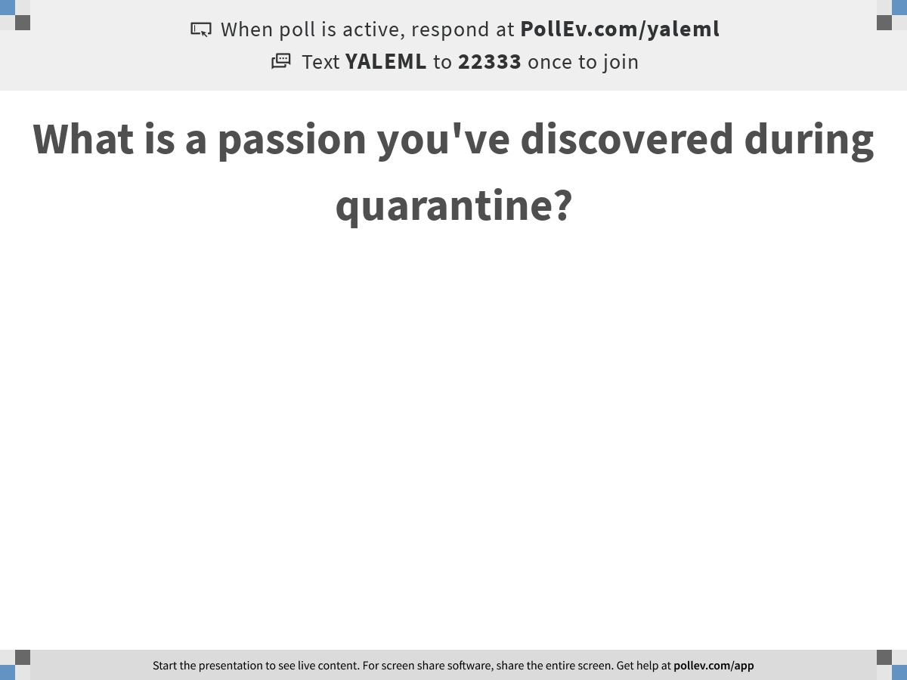
Notes:
What is a passion you've discovered during quarantine?
https://www.polleverywhere.com/free_text_polls/ji3e941oREI1Wky1RJ2Dx

Slide 2

Day 3: Denoising, Batch Correction, and Clustering
Notes:
TA introduction
Talk about not teaching code (not a programming workshop)

Slide 3
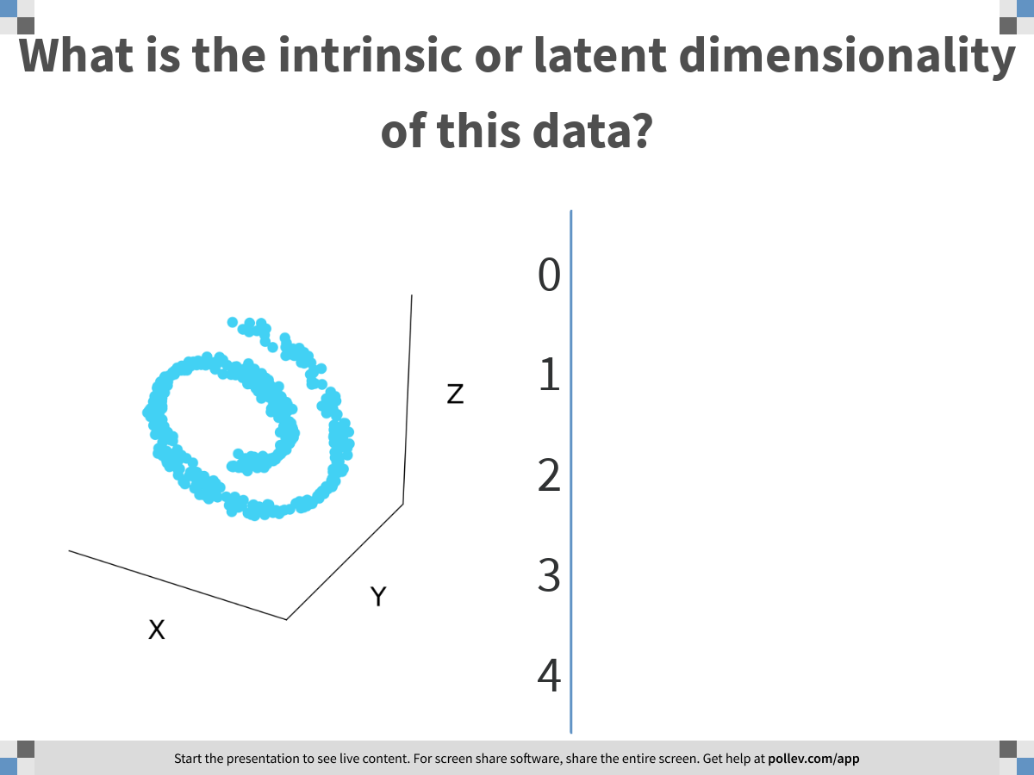
Notes:
What is the intrinsic or latent dimensionality of this data?
https://www.polleverywhere.com/multiple_choice_polls/VuedMRPvKyIBbCuDhPHwO

Slide 4
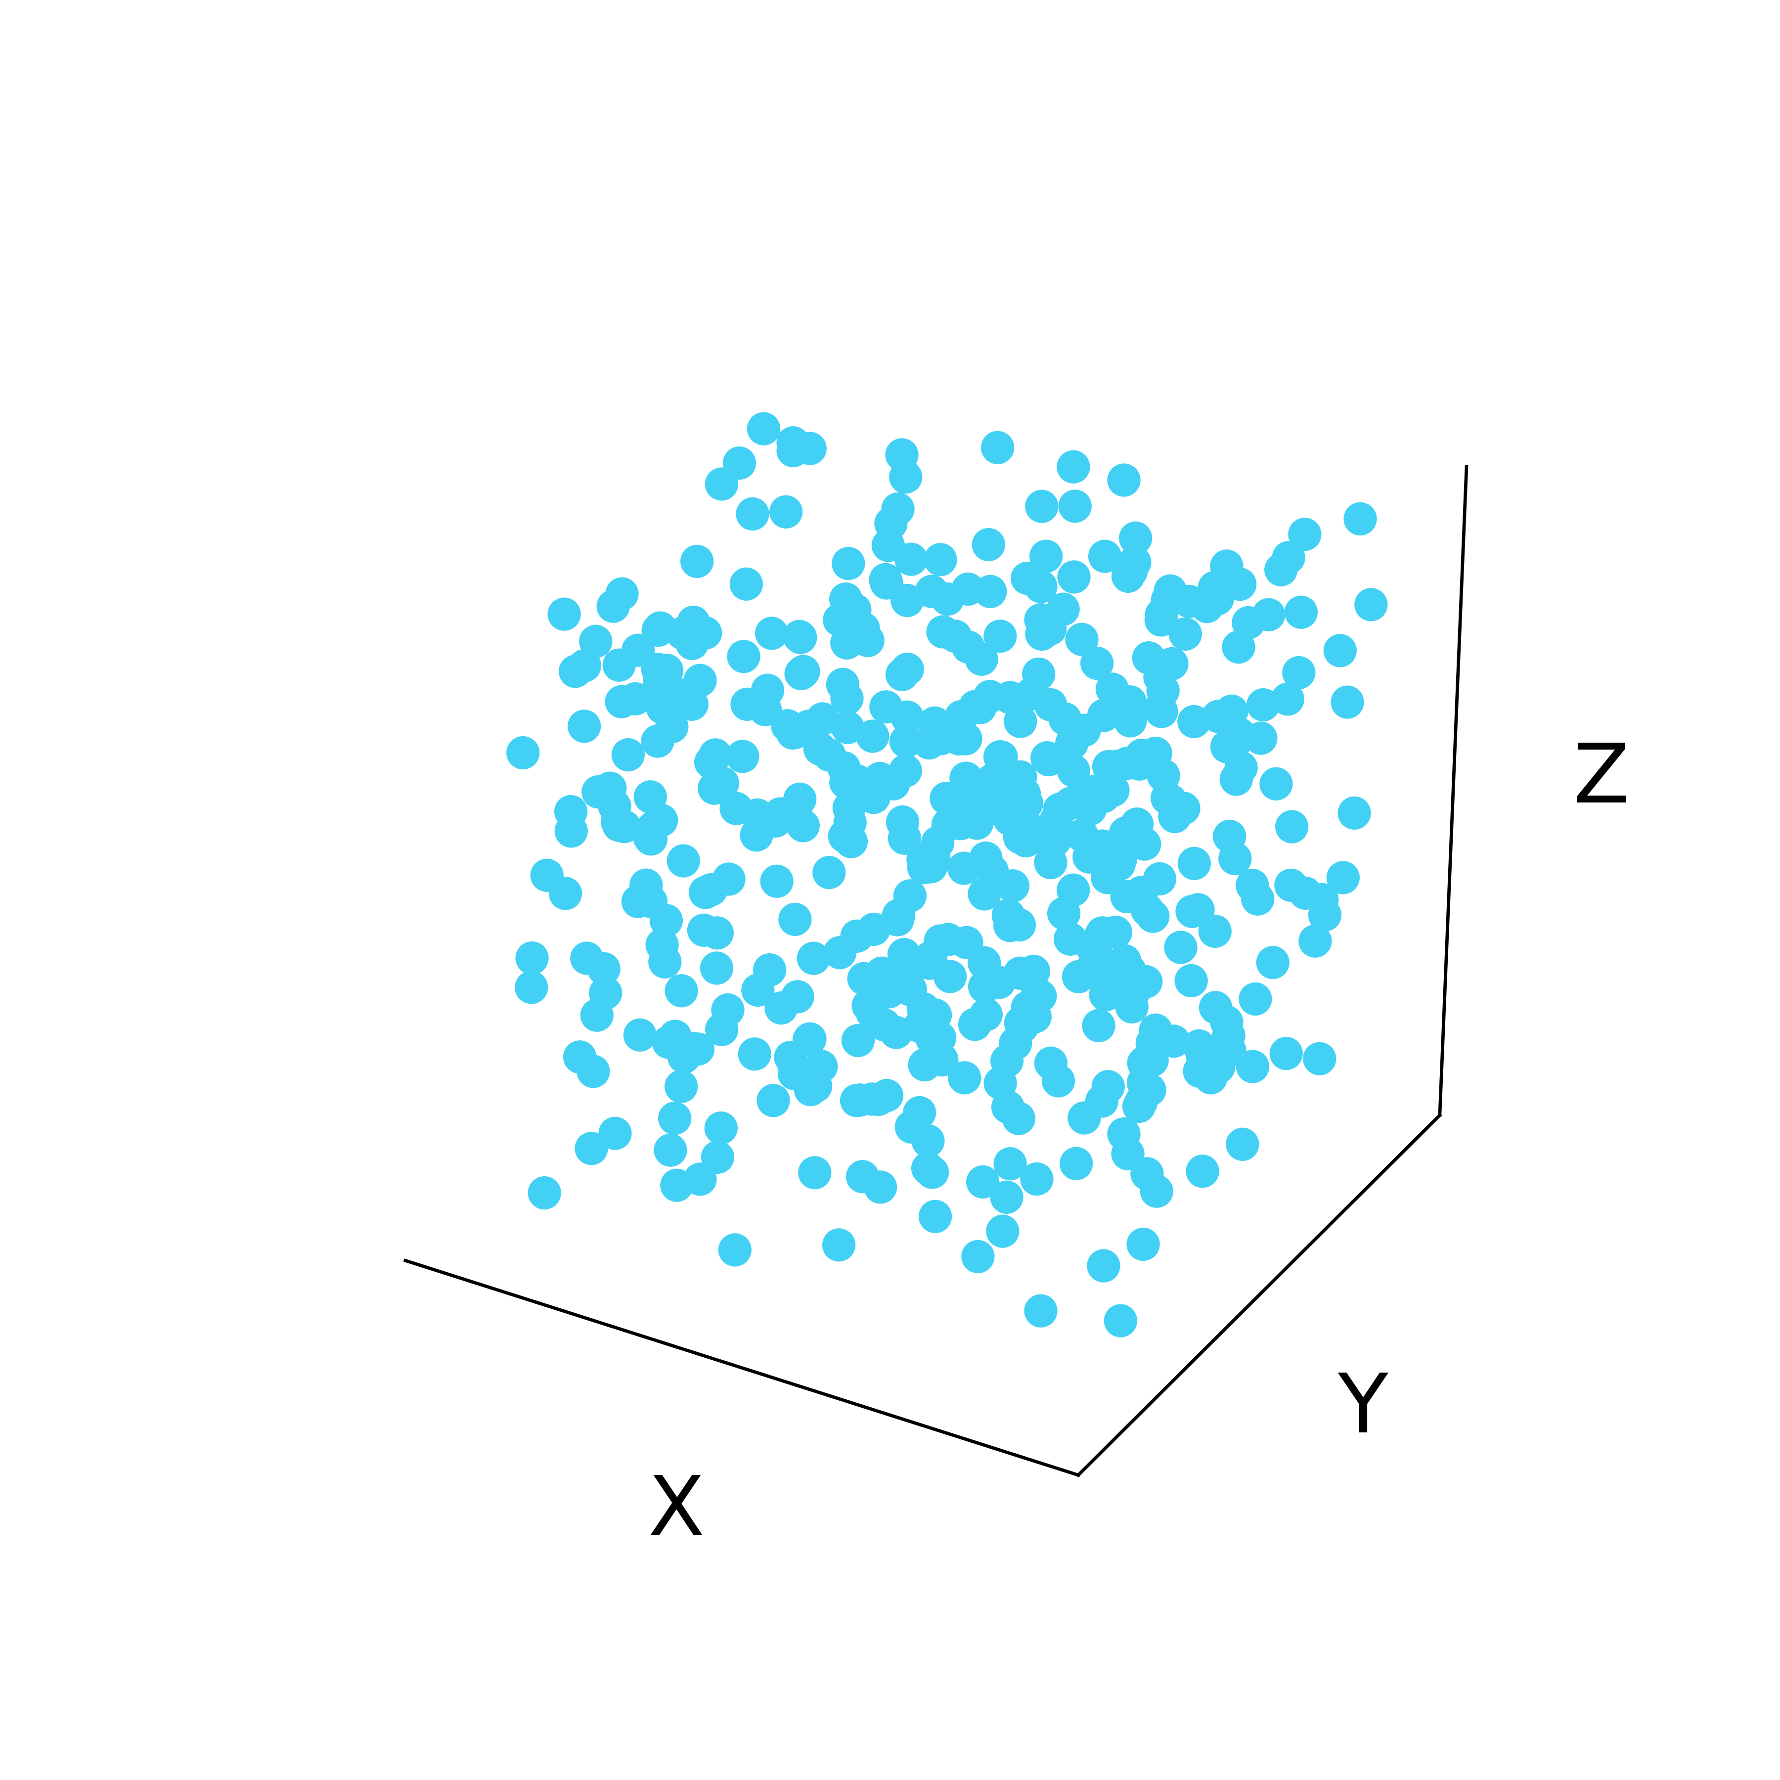
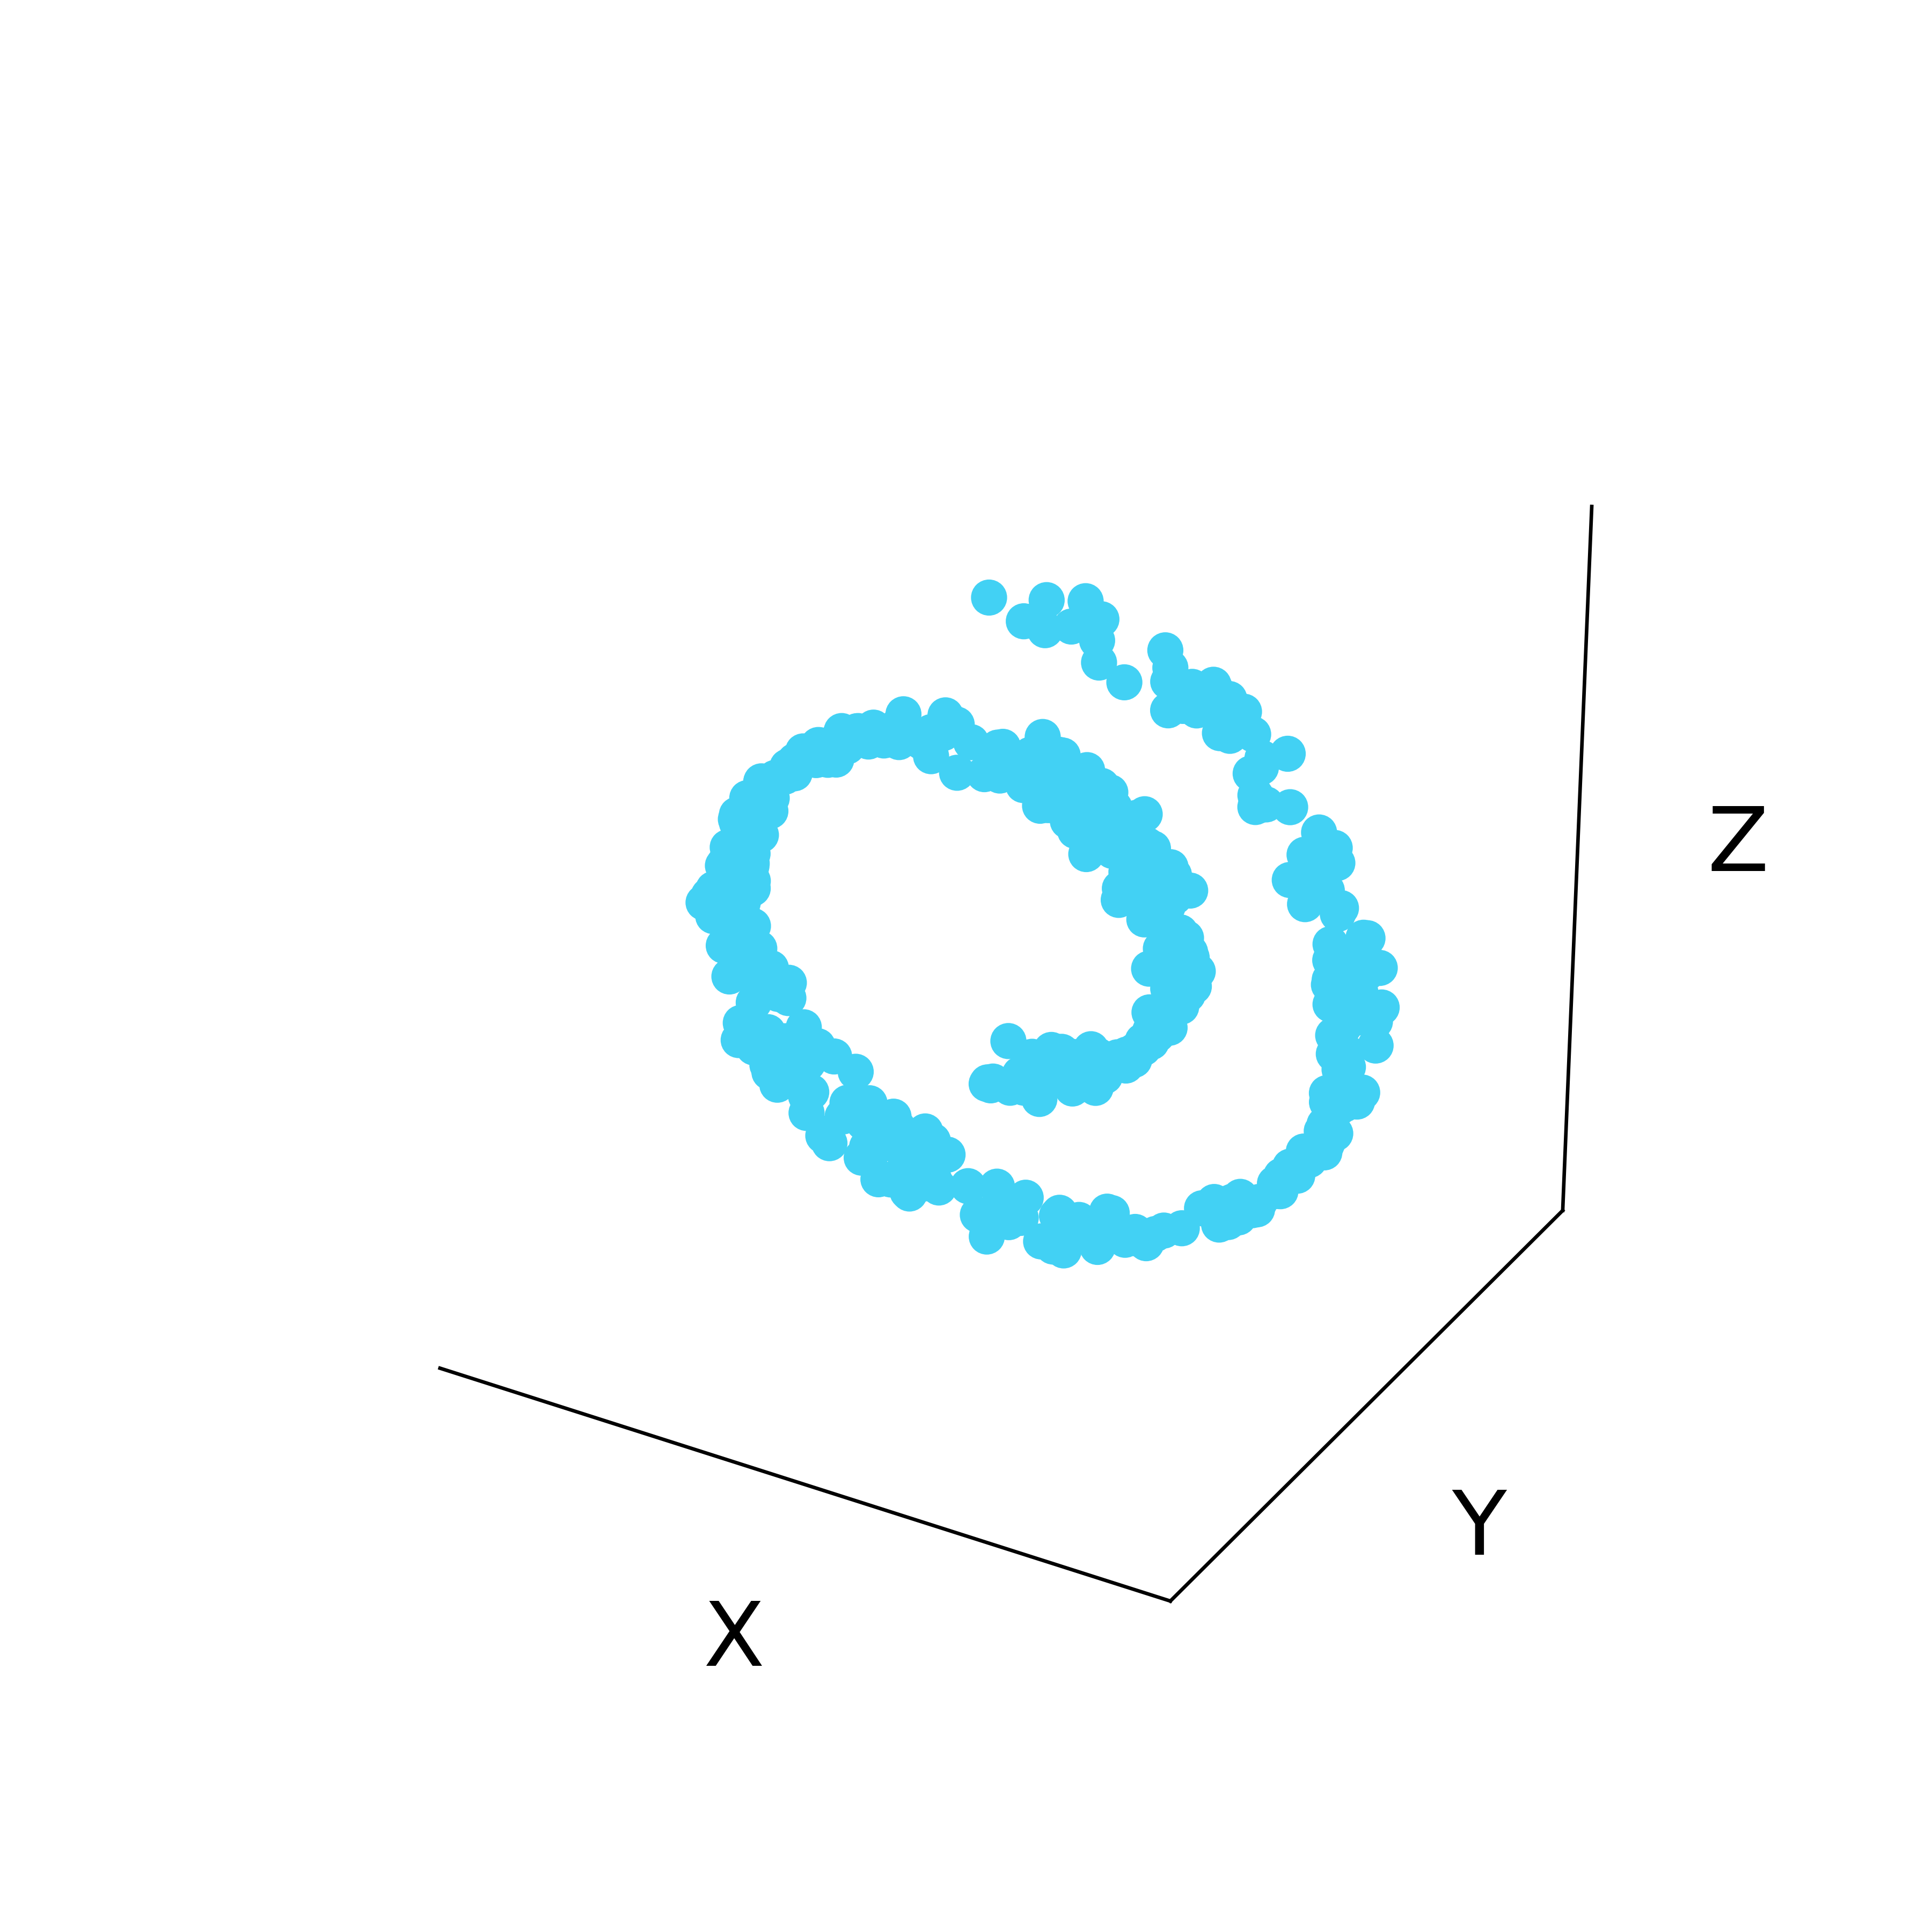
Latent structure in high dimensional data
Low-dimensional
manifold
Ambient Space

Slide 5
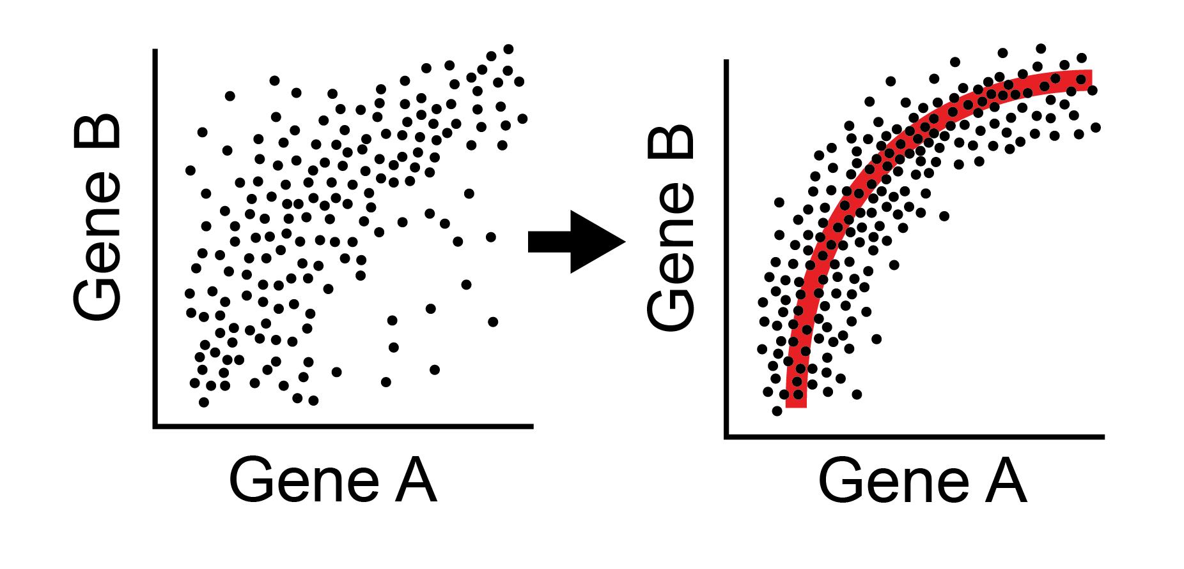
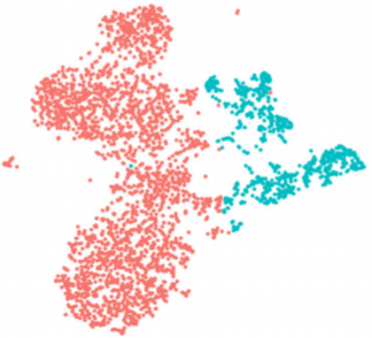
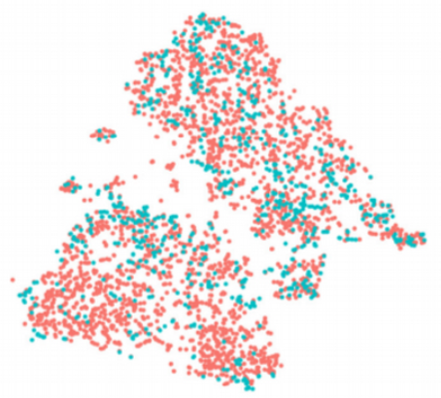
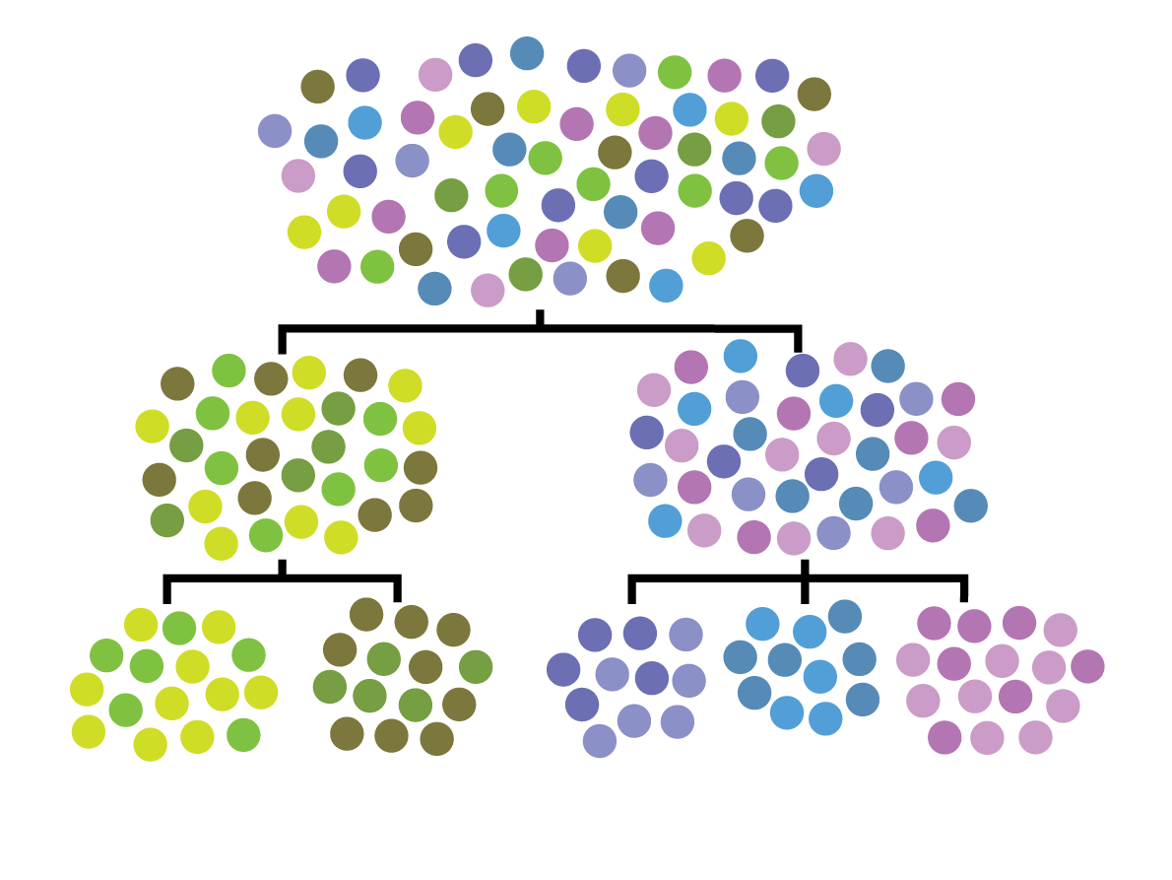
Other uses of affinity matrices, eigenvectors
Data Denoising
Batch normalization
Clustering
Data denoising and batch normalization
Clustering

Slide 6
Using the manifold model to denoise data
Notes:
TA introduction
Talk about not teaching code (not a programming workshop)

Slide 7
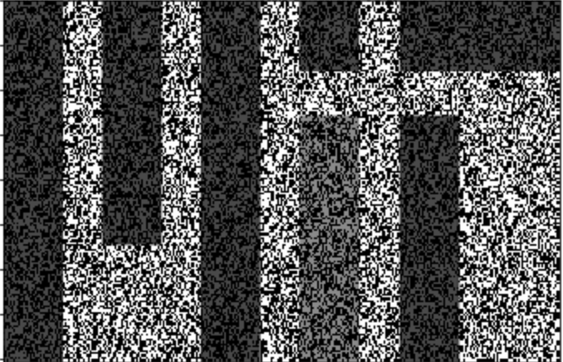
Denoising by eliminating dimensions
The number of dimensions in a data that are independent are called RANK
You can denoise data by lowering rank
Noisy image

Slide 8
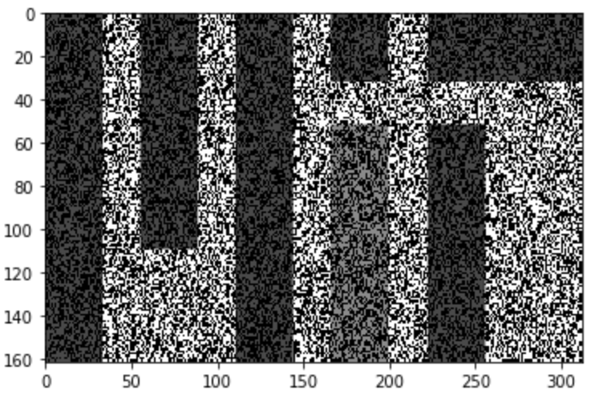
Recreate the data without noise
For this to work you have to have your dimensions be broken up into data dimensions and noise dimensions
Noisy image on the right is broken up into columns and rows instead
What do we do?

Slide 9
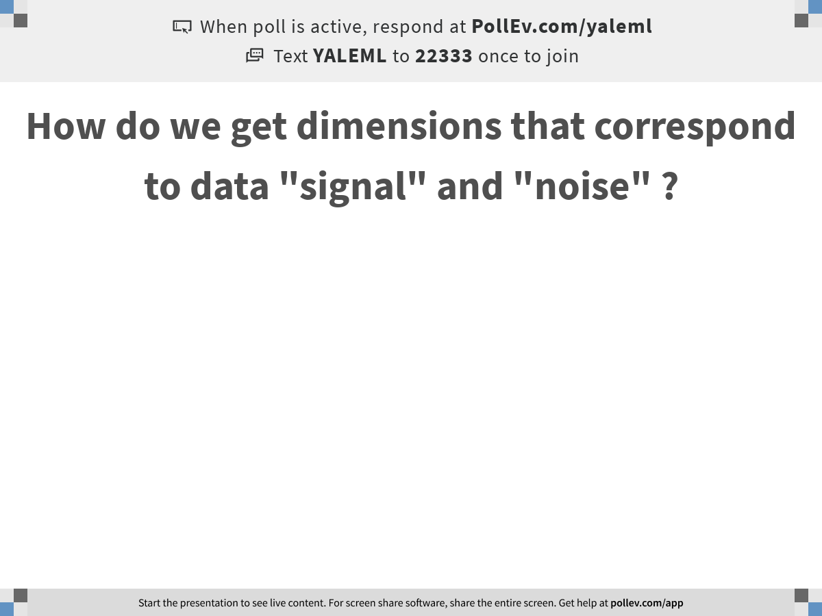
O cor
Notes:
How do we get dimensions that correspond to data "signal" and "noise" ?
https://www.polleverywhere.com/free_text_polls/3OVnyzZchdADfJIdZXVJf

Slide 10
PCA splits signal and noise
The axes with a lot of variation are likely to correspond to data
Axes with little variation correspond to noise directions
The amount of variation captured in each eigenvector is given by its eigenvalue
PC1 will have the highest eigenvalue, captures the most variation ..
PC2 next most
And so on…

Slide 11
SVD: Process similar to Eigendecomposition on non-square matrices
Singular values are eigenvalues of MM* or M*M
Singular vectors are eigenvectors of MM* or M*M
For a mean centered feature matrix the singular vectors U are also PCs

Slide 12
Low Rank approximation
Eliminate the singular vectors with low singular values and recreate the matrix

Slide 13
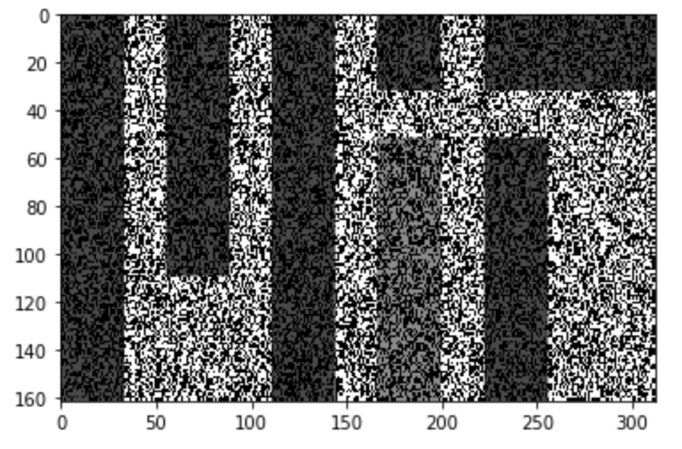
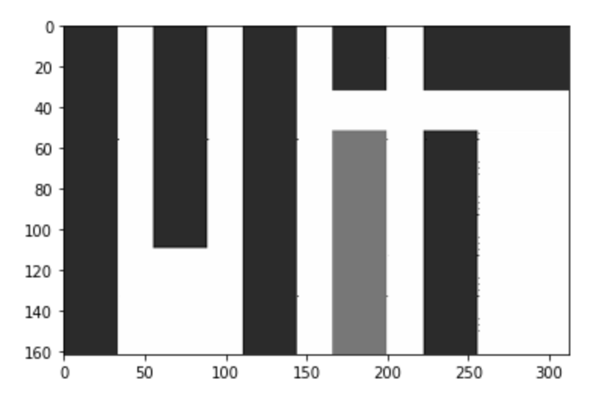
Low Rank Approximation on MIT matrix
Image from https://medium.com/@amelie_yeh/

Slide 14
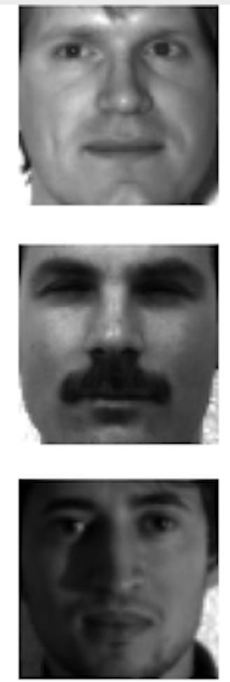
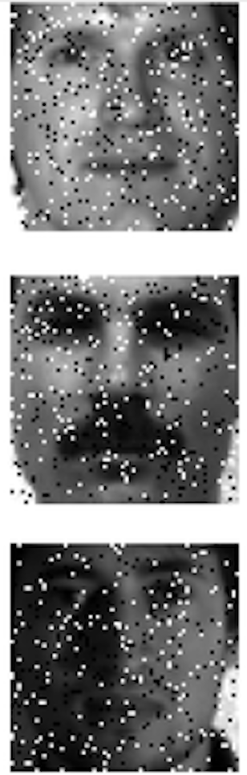
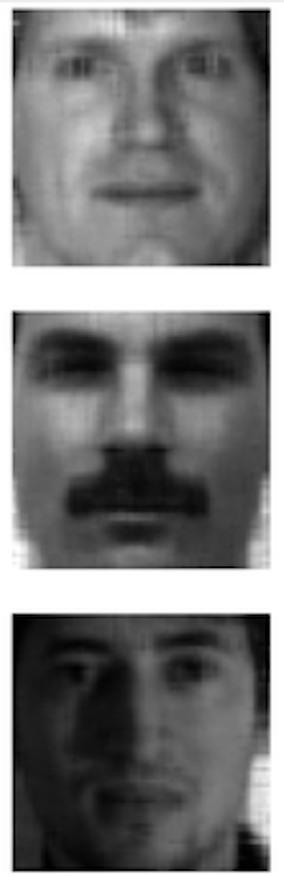
Data is smooth, Noise is jumpy
Can take off noise by taking off low-eigenvalued eigenvectors

Slide 15
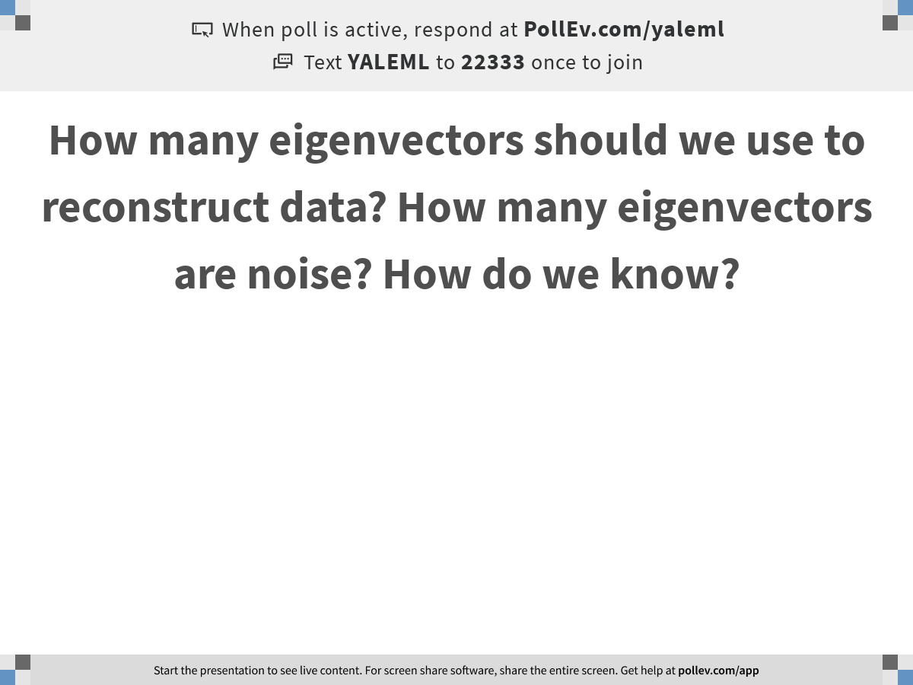
Notes:
How many eigenvectors should we use to reconstruct data? How many eigenvectors are noise? How do we know?
https://www.polleverywhere.com/free_text_polls/cCv6DTzZZalEfCgrnKGfB

Slide 16
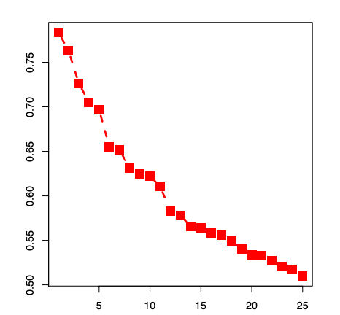
Eigengap
Jumps in eigenvalues
Might give you a clue

Slide 17
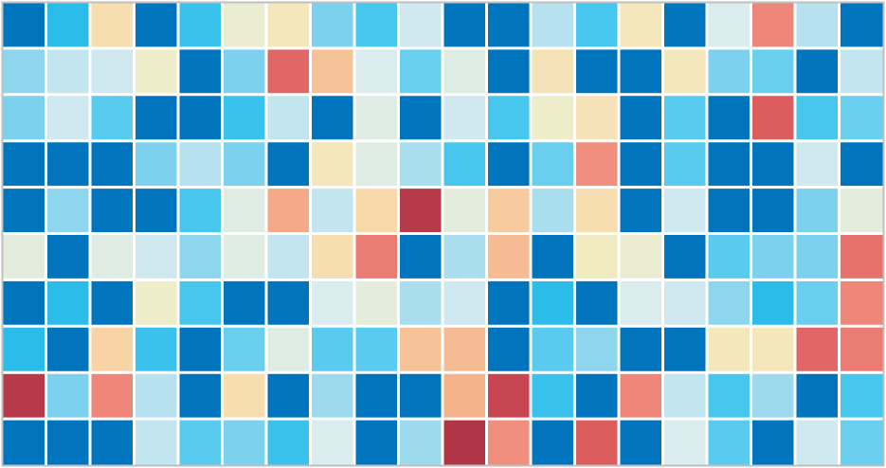
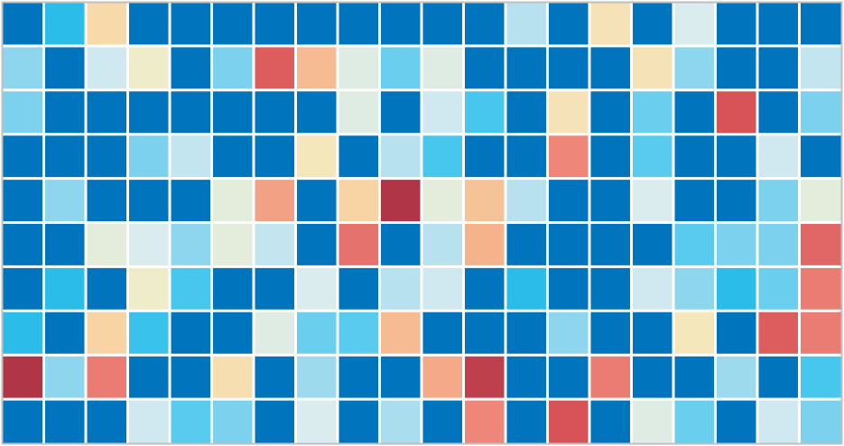
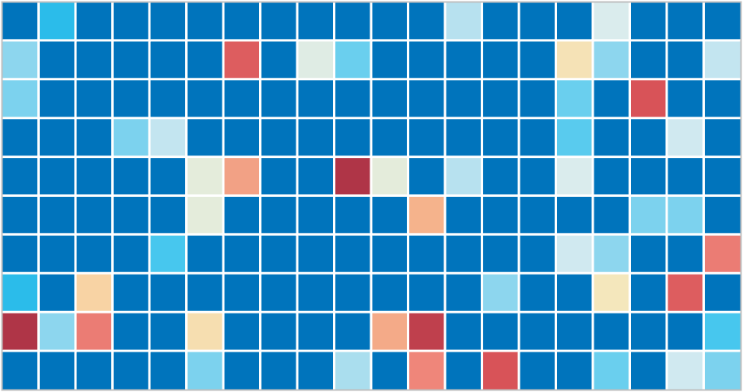
Genes
Cells
Data is noisy and sparse (scRNA-seq)
Notes:
ideally: measure the expression of every gene in every
Samples only a small part of the transcriptome per cell
-- Tens of millions of individual measurements

Slide 18
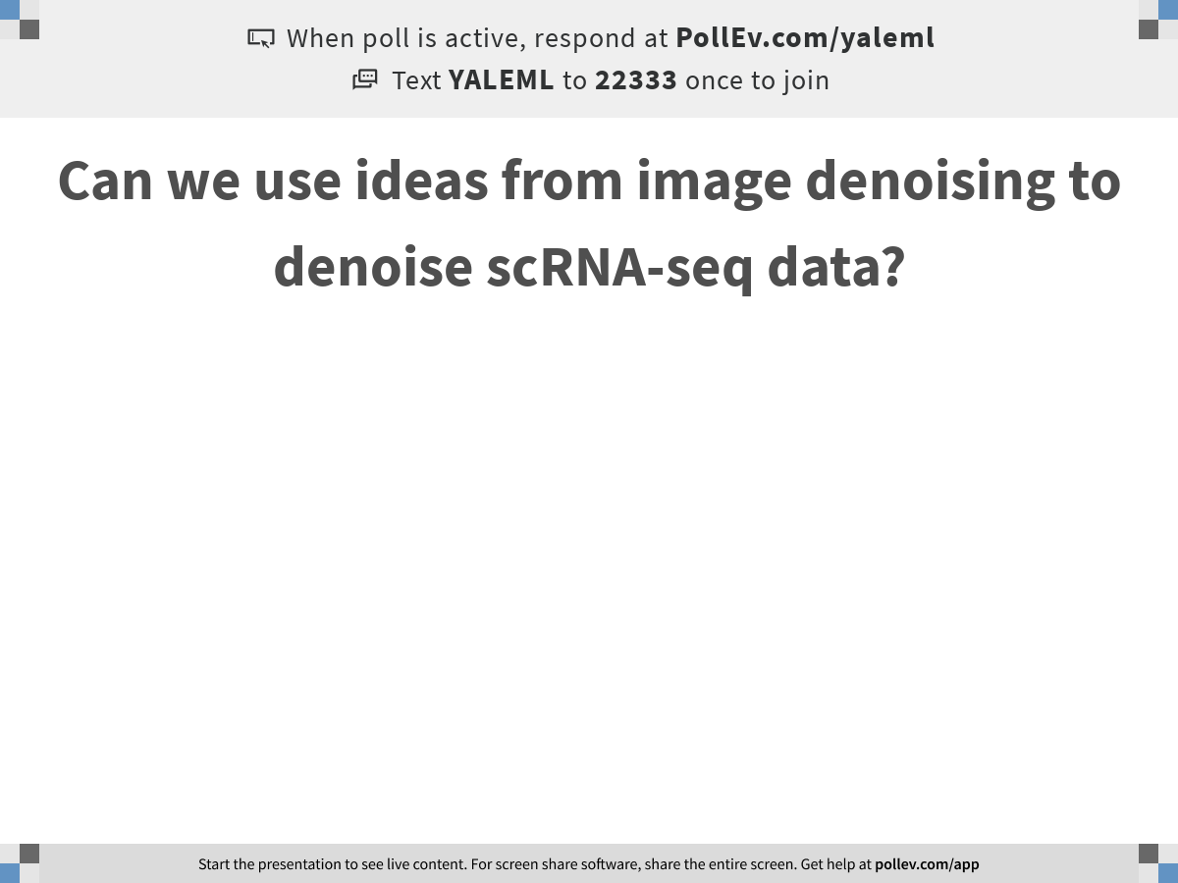
Notes:
Can we use ideas from image denoising to denoise scRNA-seq data?
https://www.polleverywhere.com/free_text_polls/MHGsb8S3NA2p28T4r1NSd

Slide 19
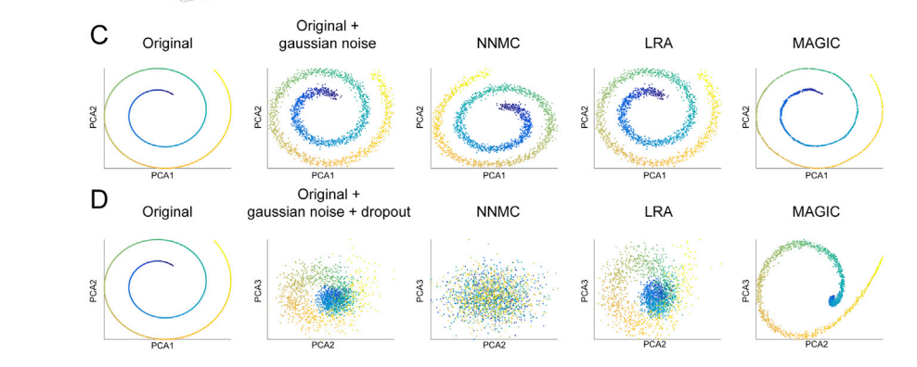
Low rank approximation for non-linear data
Problem with PCA/Single Value Decomposition (SVD): it takes off linear dimensions in data, noise can be along the non-linear data manifold

Slide 20
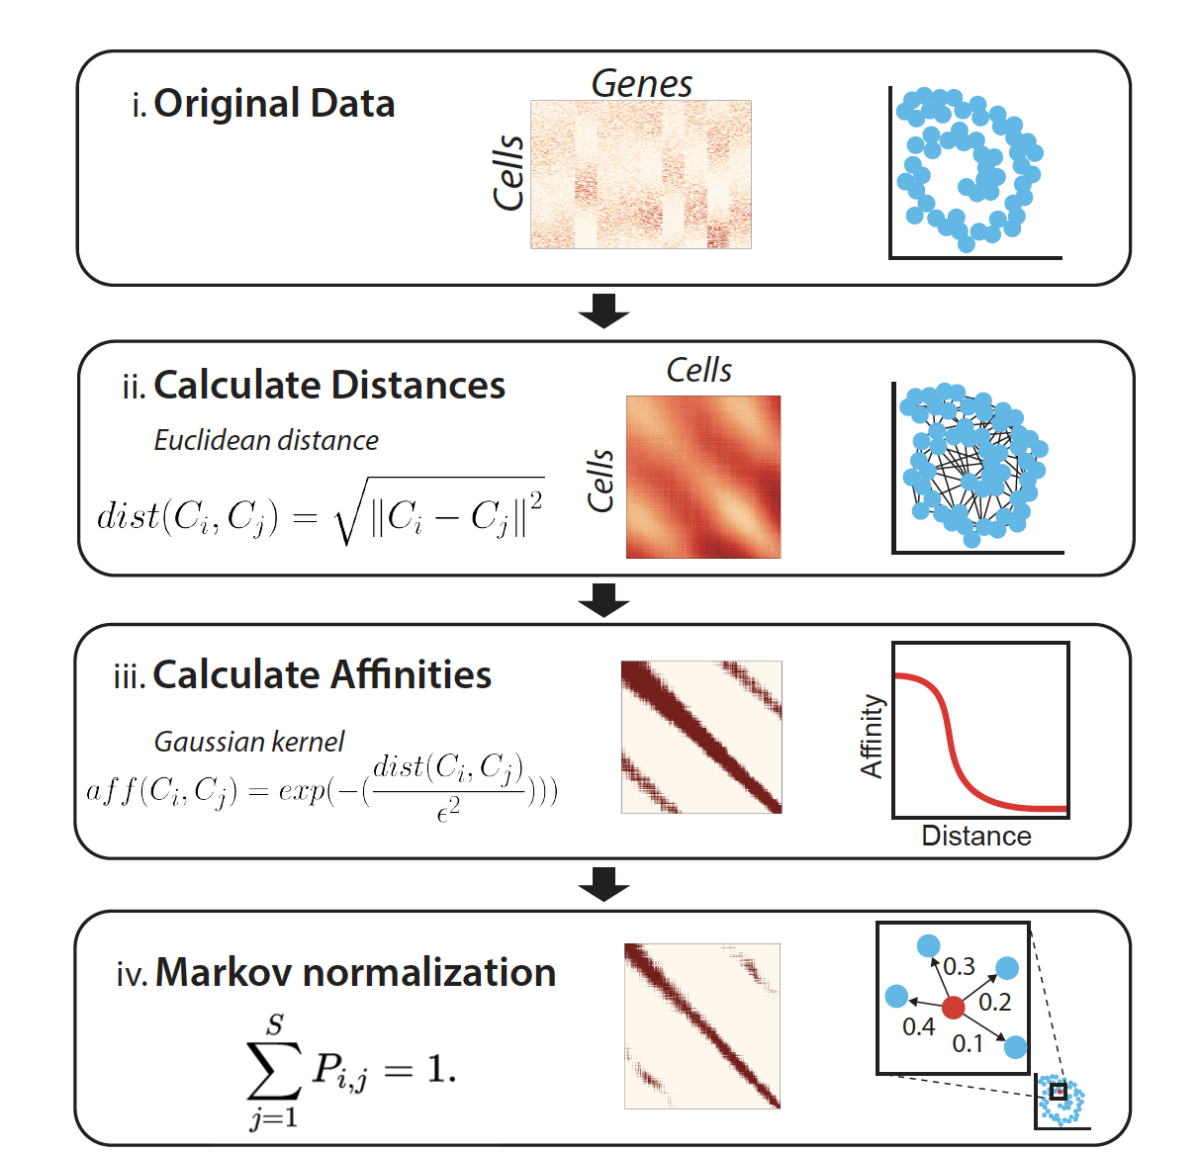

Slide 21
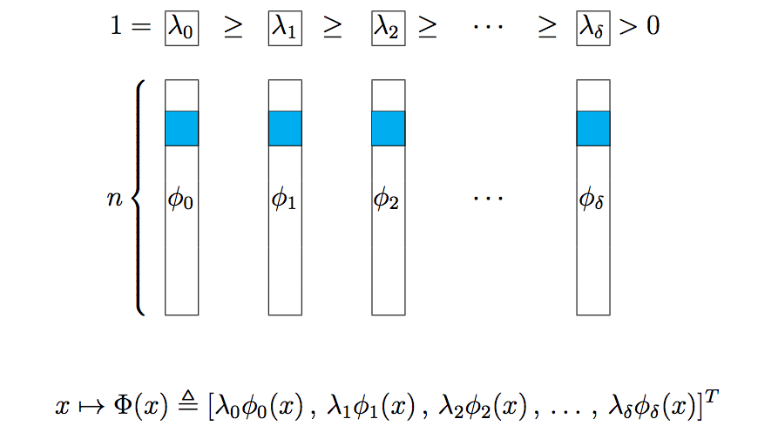
Eigenvectors of Affinity Matrix

Slide 22
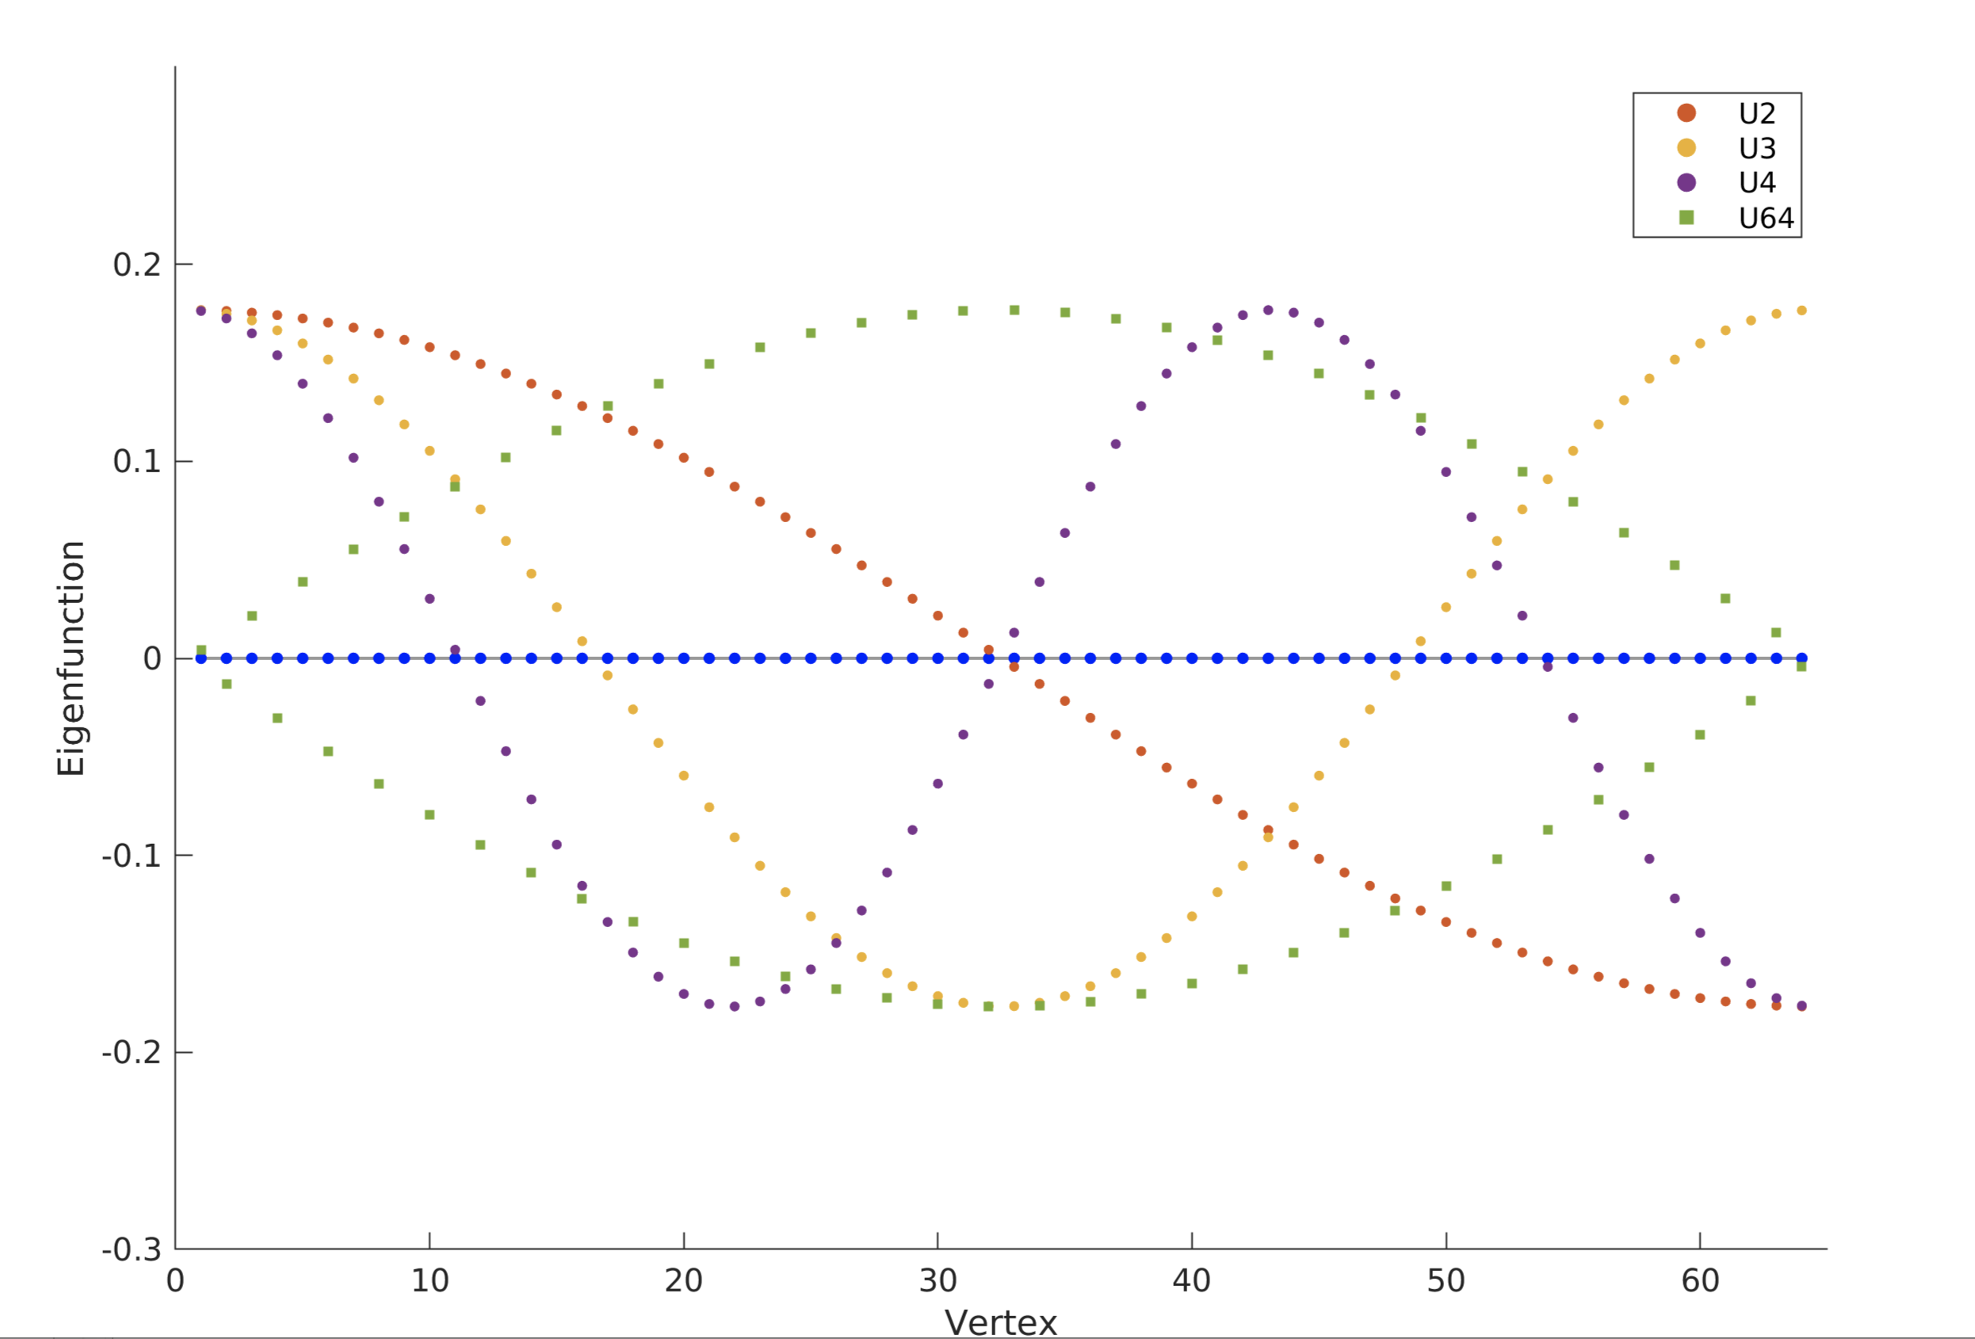
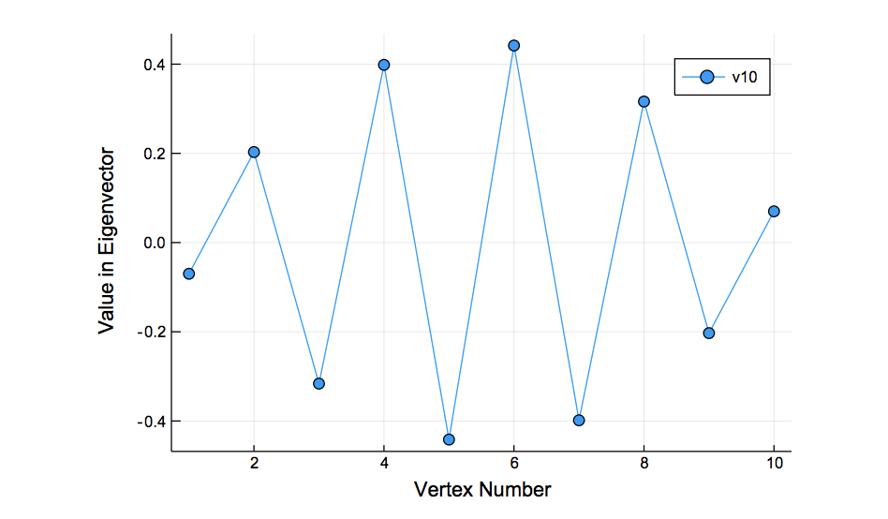
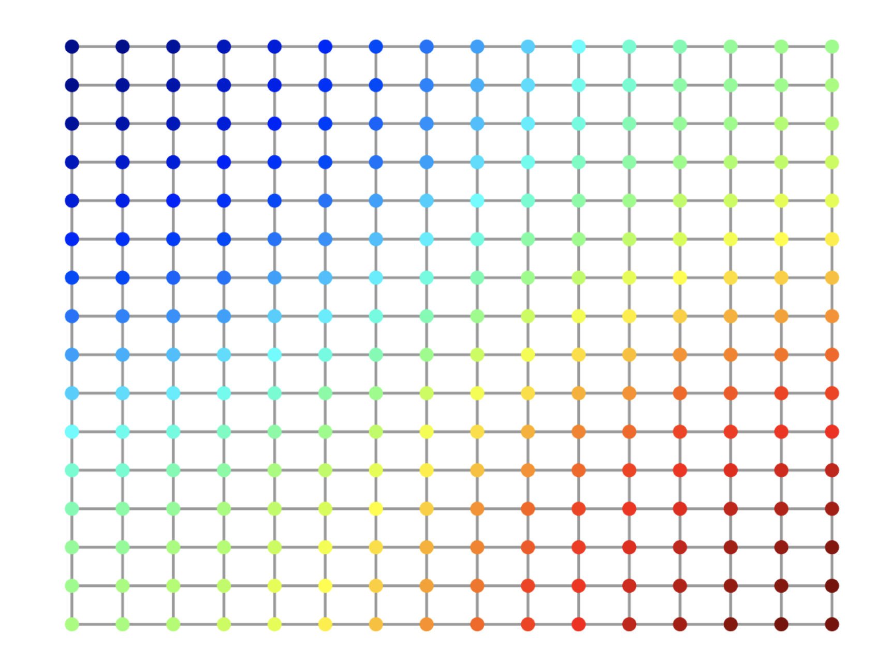
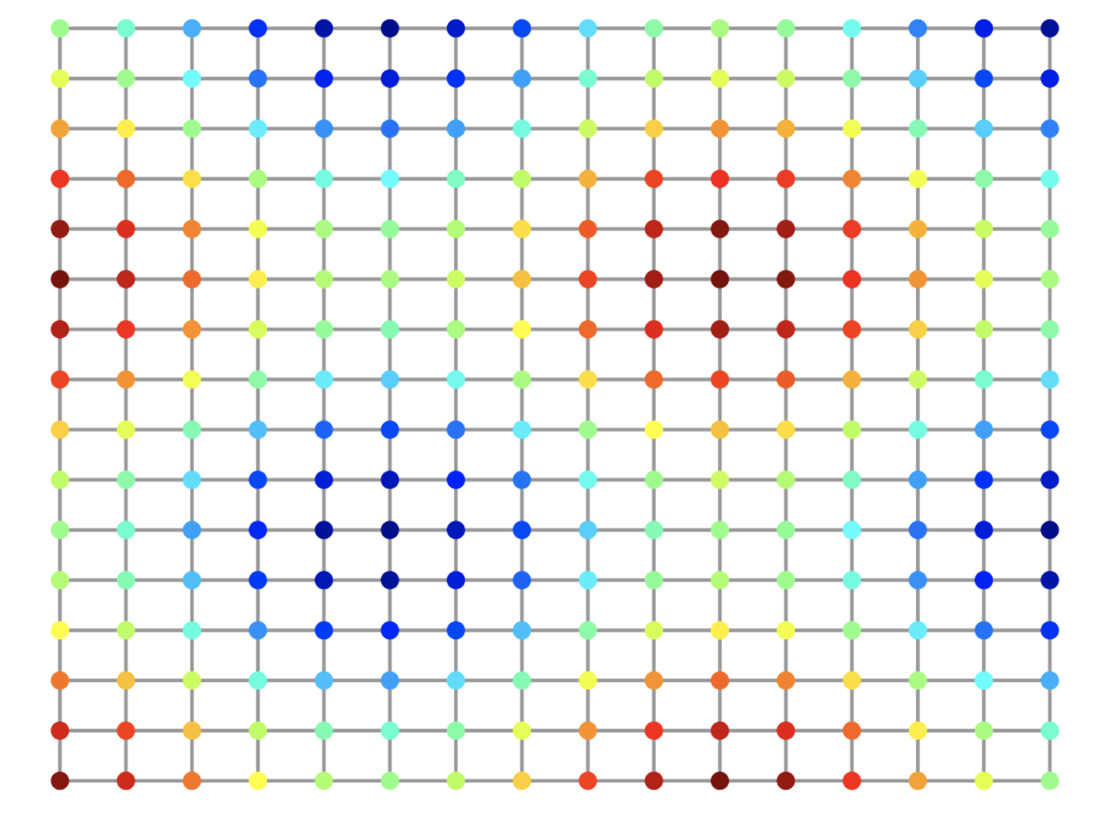
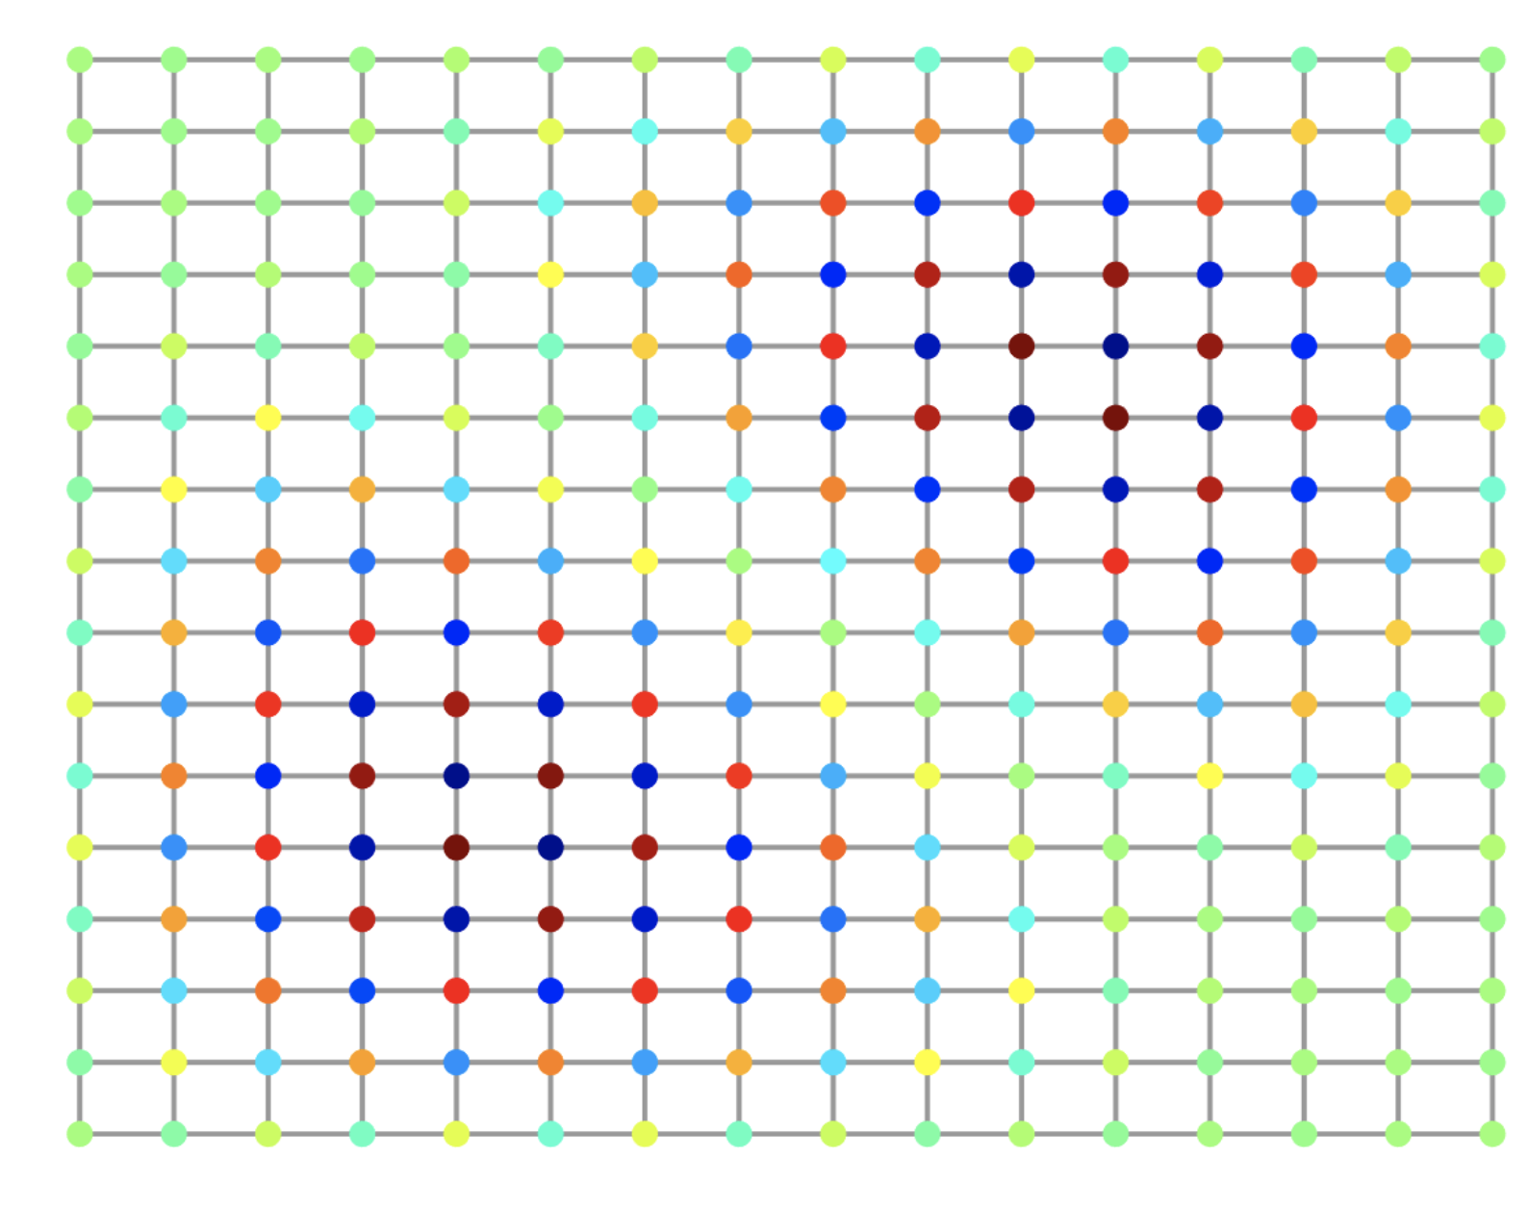
Eigenvectors are frequency harmonics
2nd Eigenvector
10th Eigenvector
2nd to last eigenvector

Slide 23
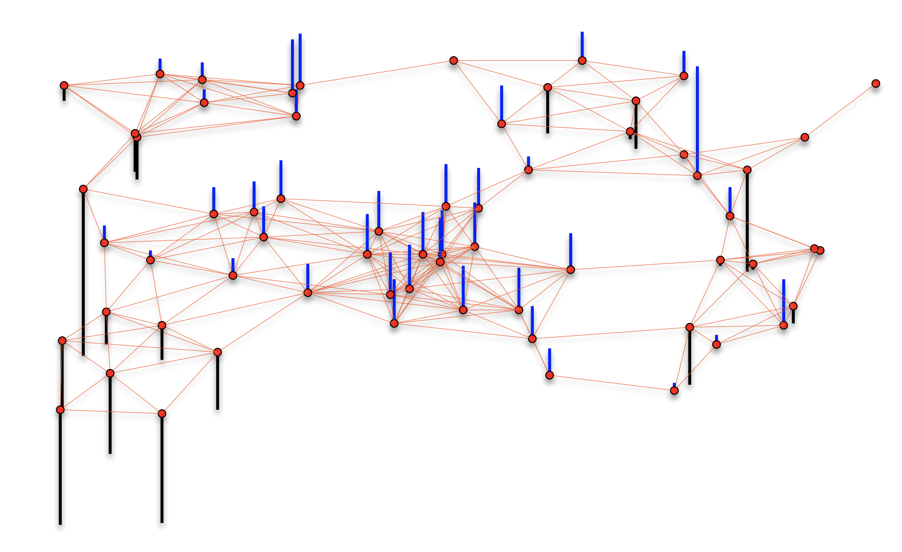
Cells are nodes, mRNA gene-counts are signals on a graph

Slide 24
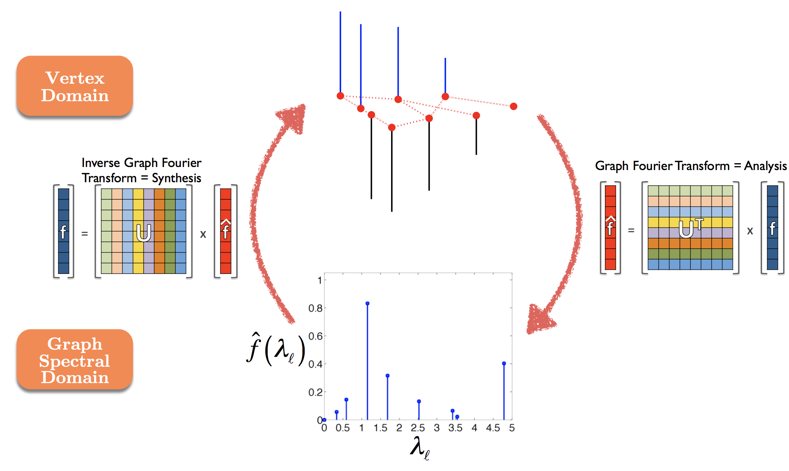
Graph Fourier Transform

Slide 25
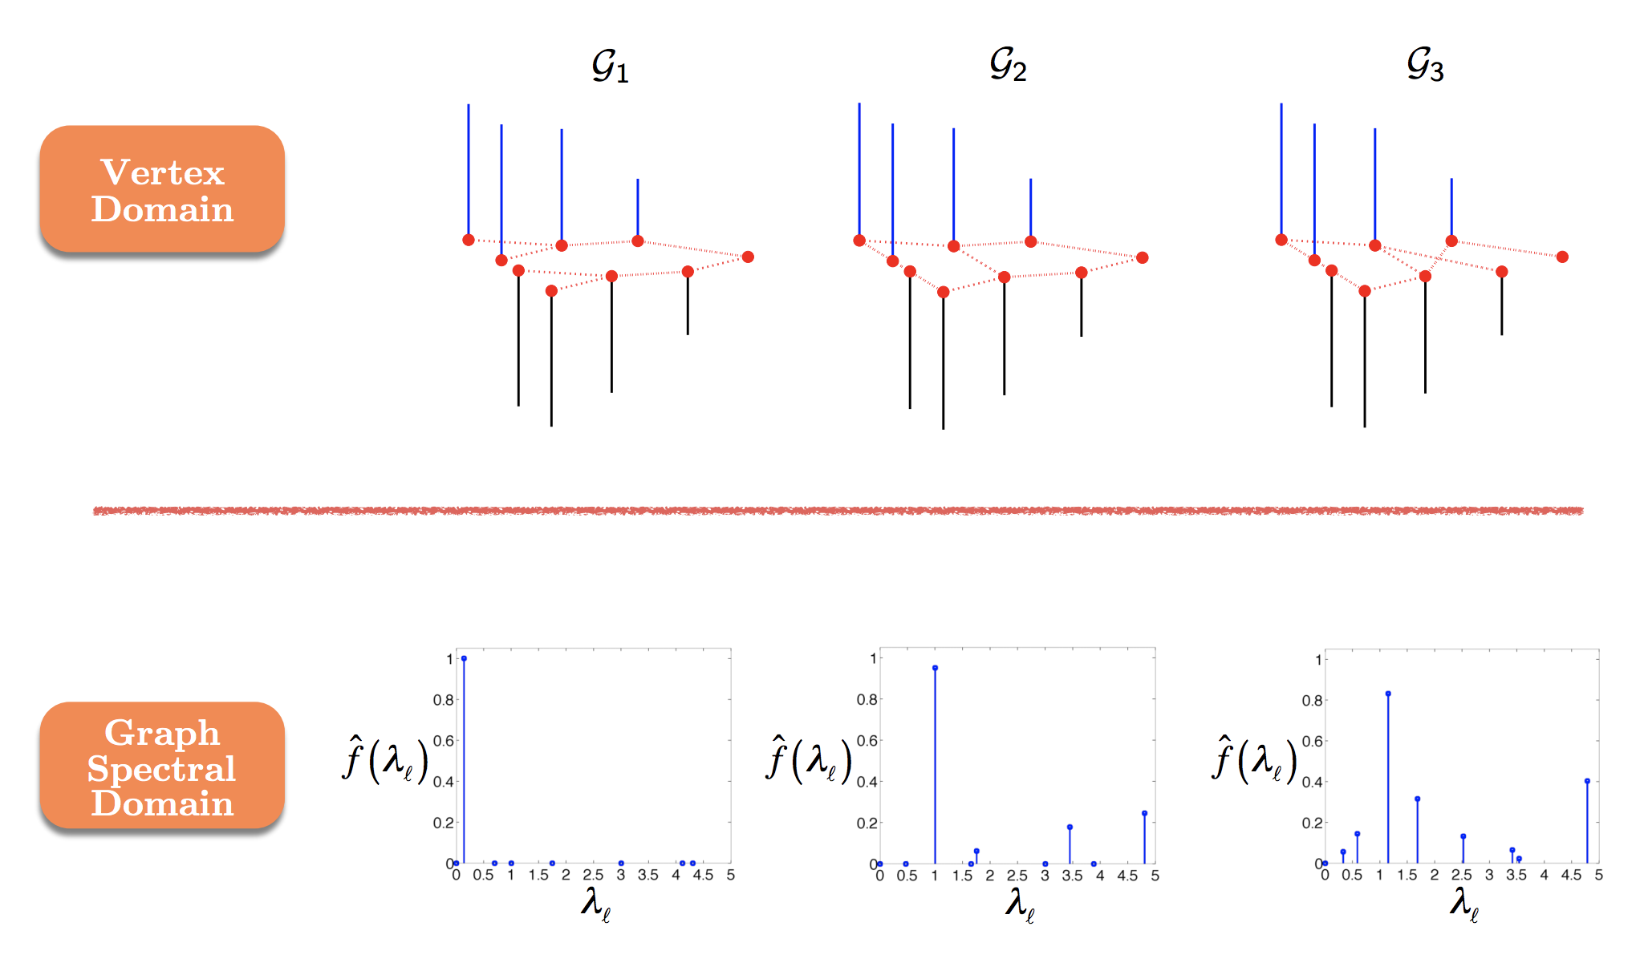

Slide 26
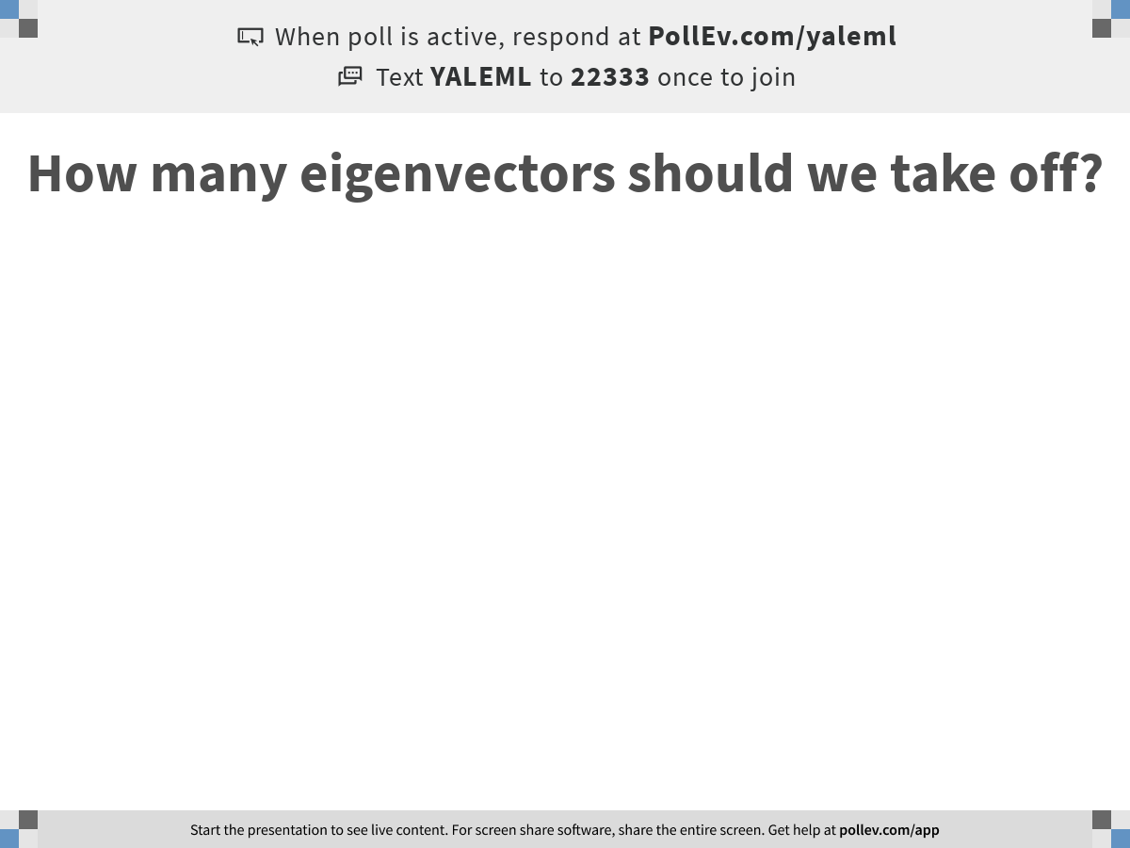
Notes:
How many eigenvectors should we take off?
https://www.polleverywhere.com/free_text_polls/P7vNDFrwpqLTCQM2o2TgV

Slide 27
MAGIC
Softly filters eigenvectors, down-weights them in a regular scheme rather than totally taking them off
This is called low-pass filtering on the spectrum of the graph

Slide 28
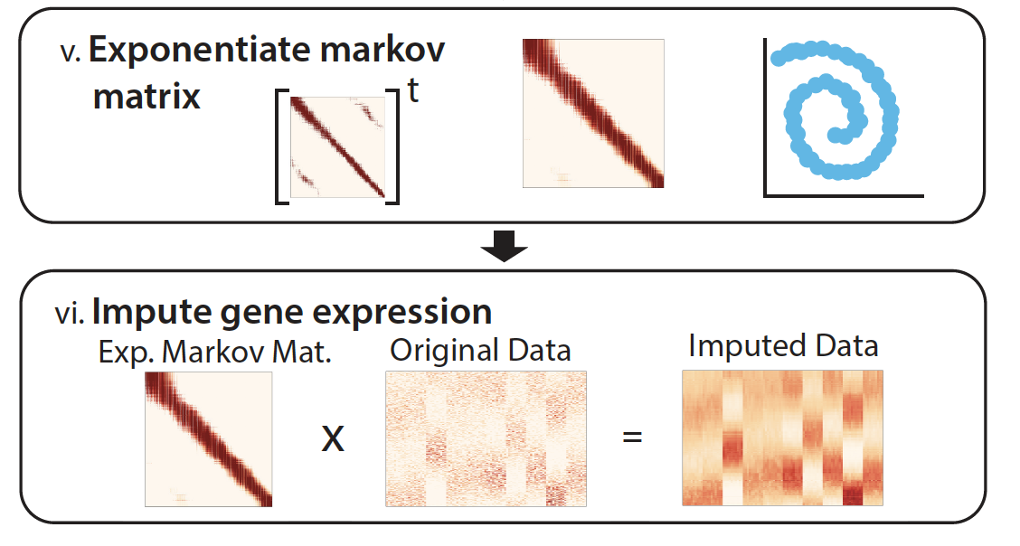
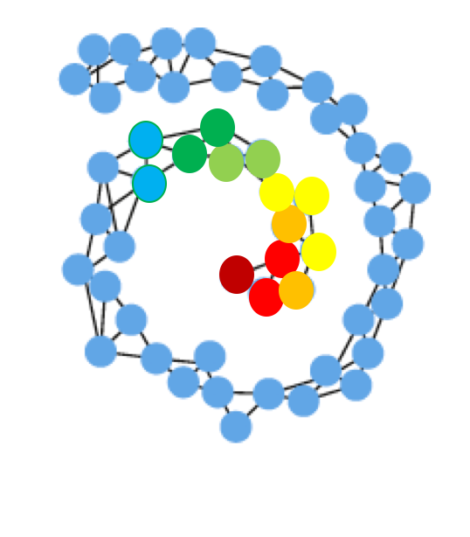
Imputation Step = Smoothing on Graph

Slide 29
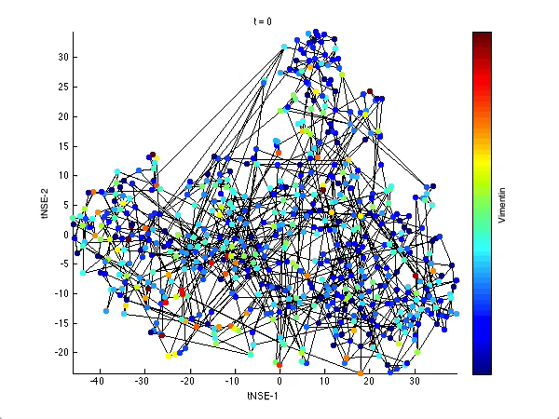
Vertex Domain
Smooths signal on graph
Takes weighted average of neighbor

Slide 30
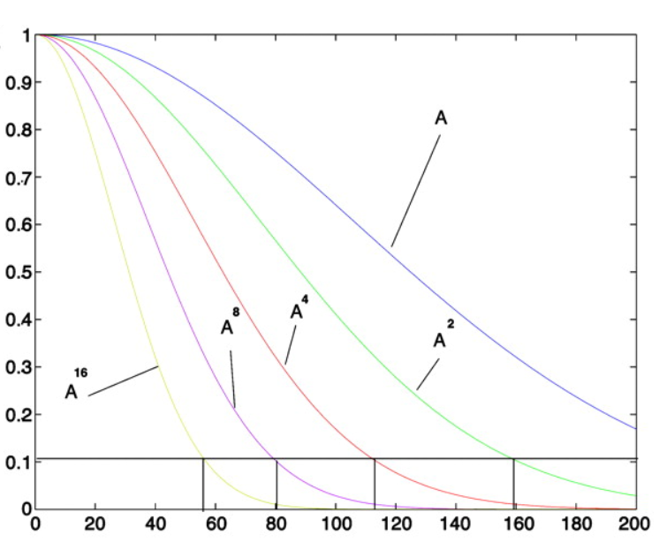
Low pass filter of Eigenvectors

Slide 31
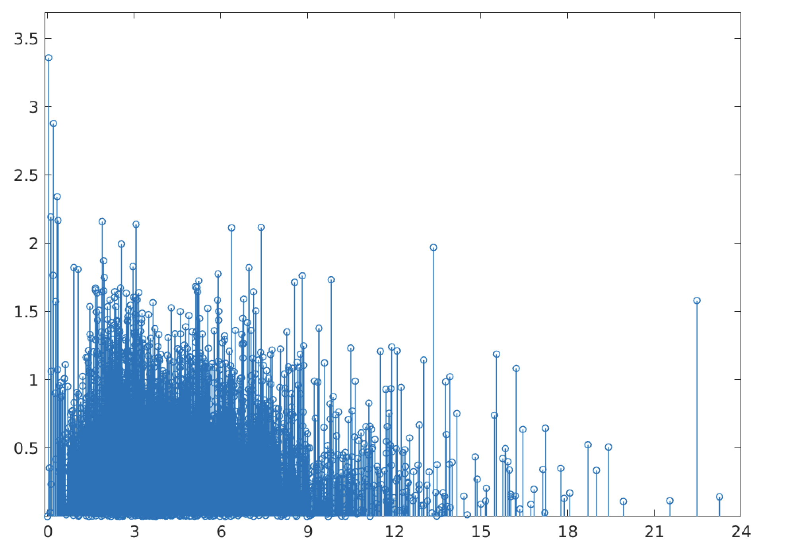
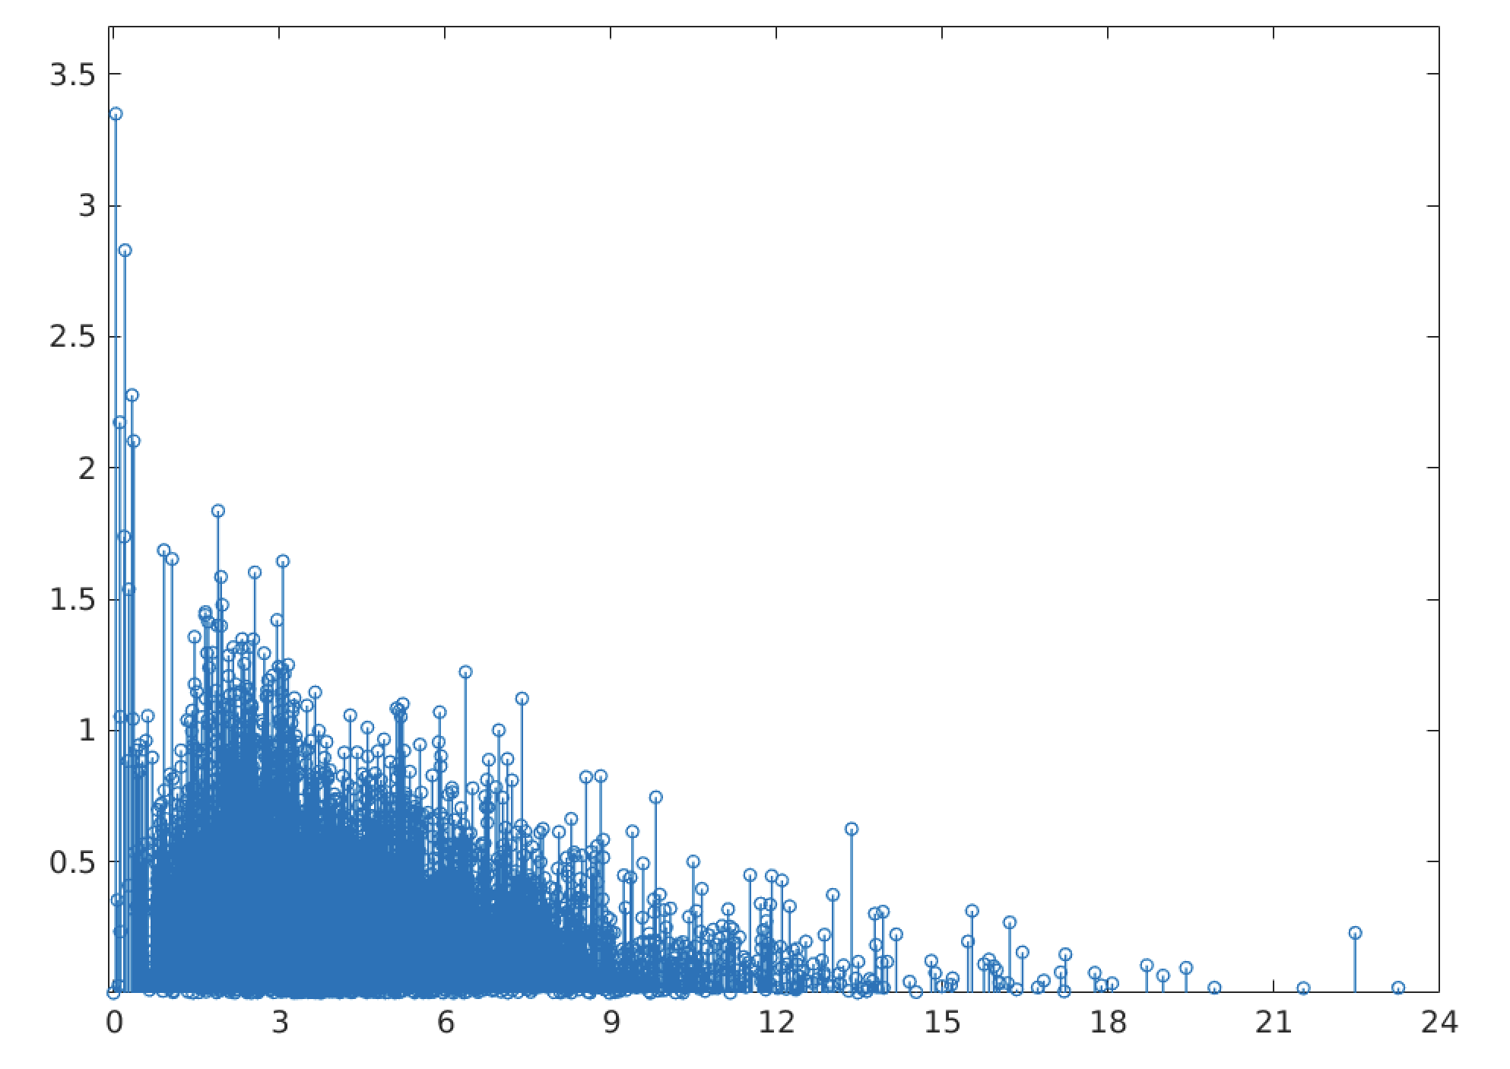
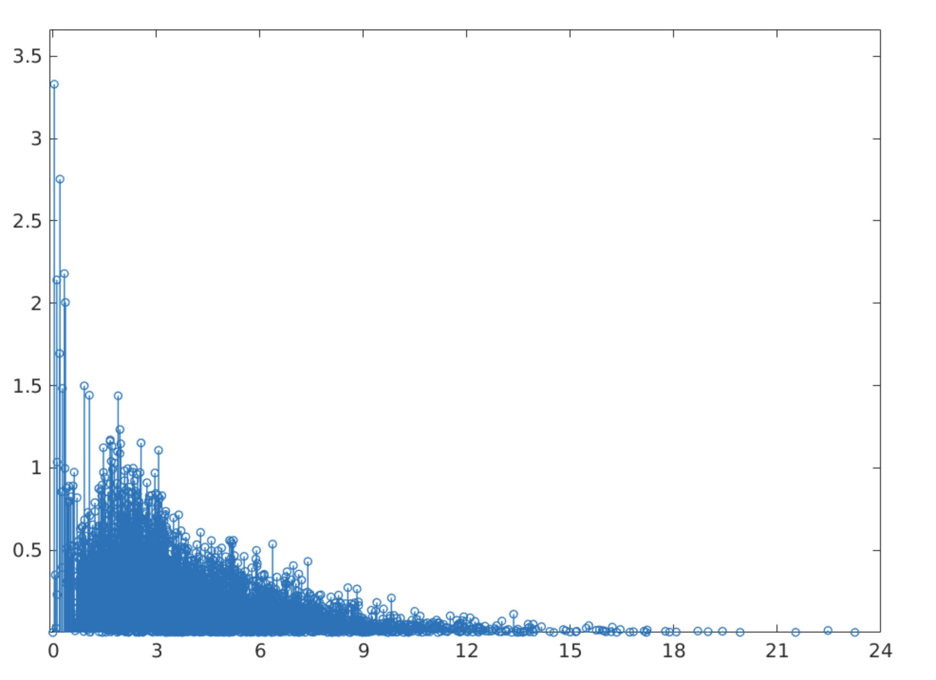
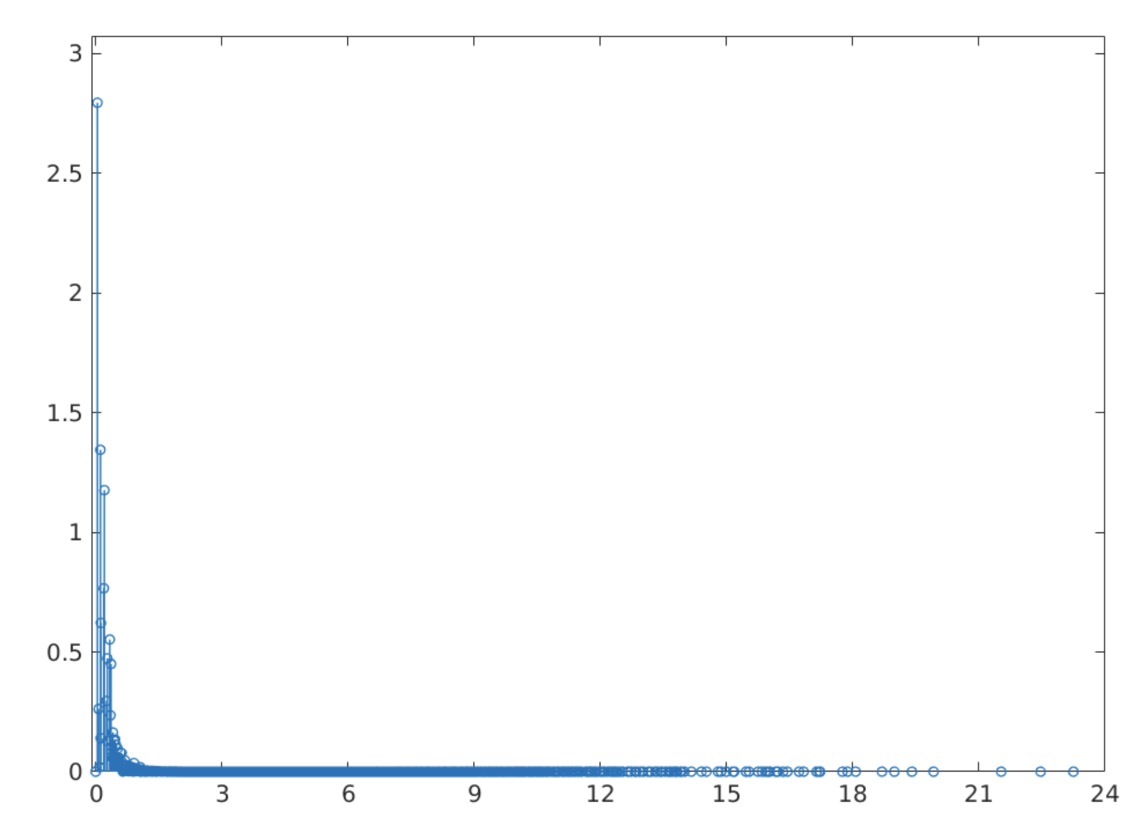
Frequency domain
No Smoothing
T=2
Kills high frequency
noise
T=5
T=100

Slide 32
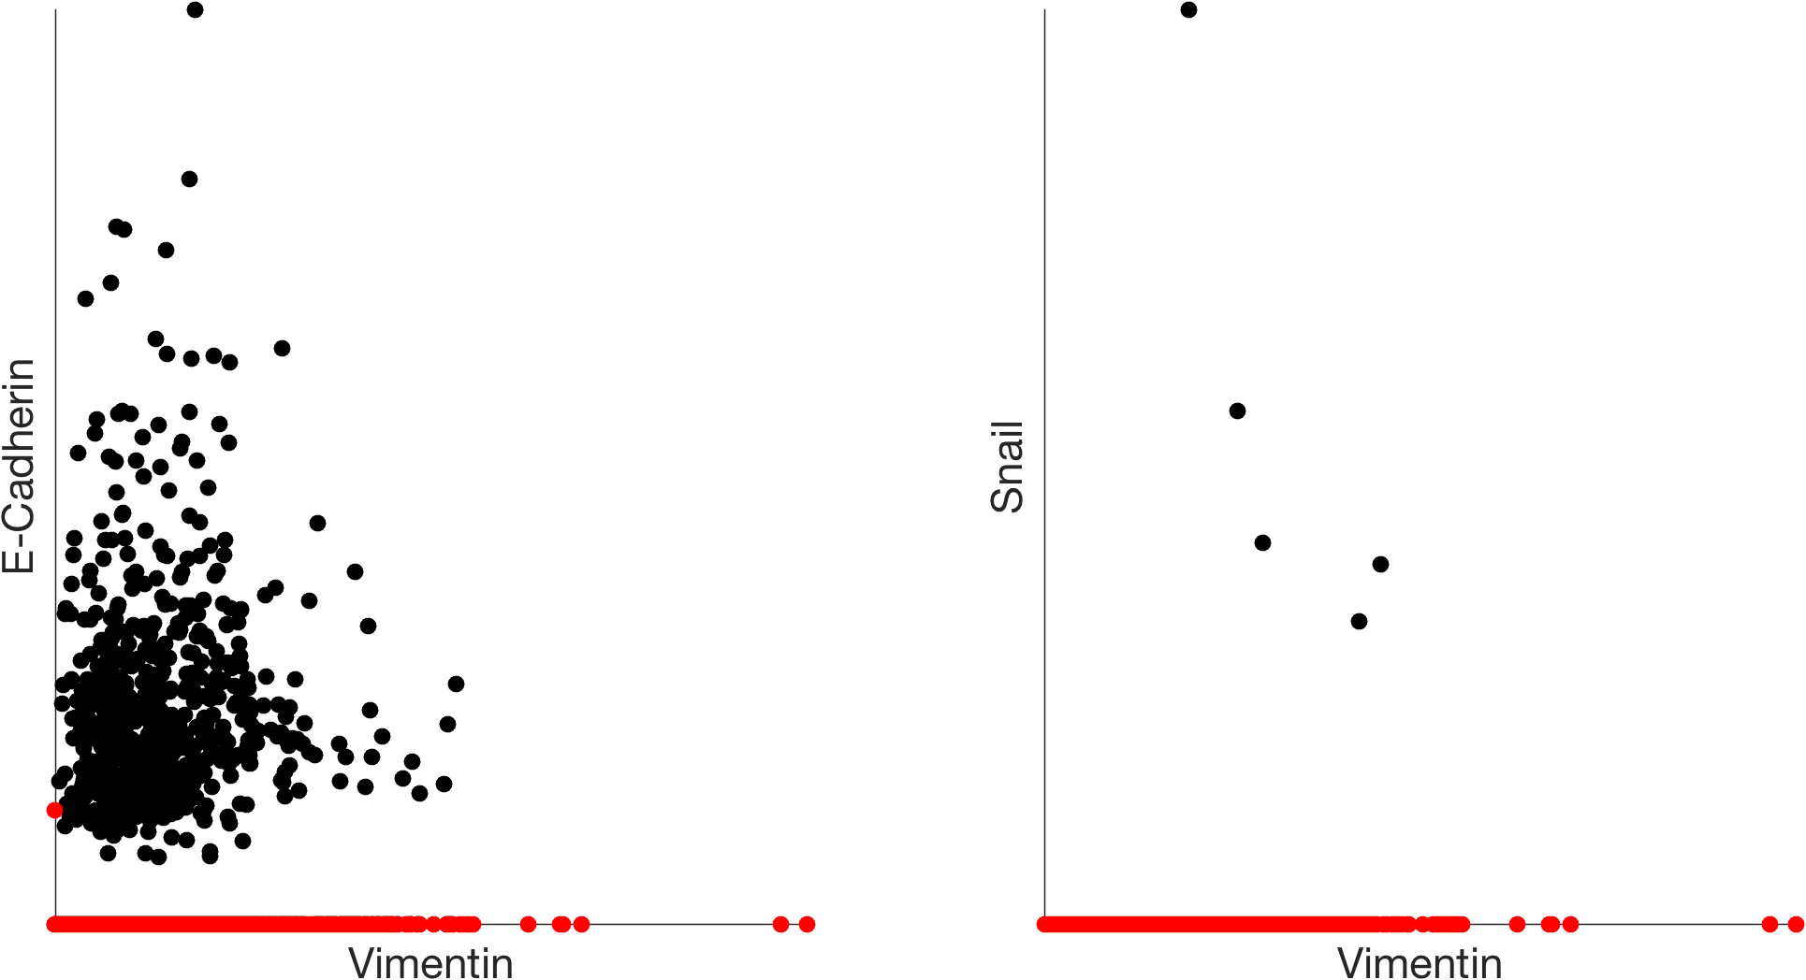
missing values
original data with dropout

Slide 33
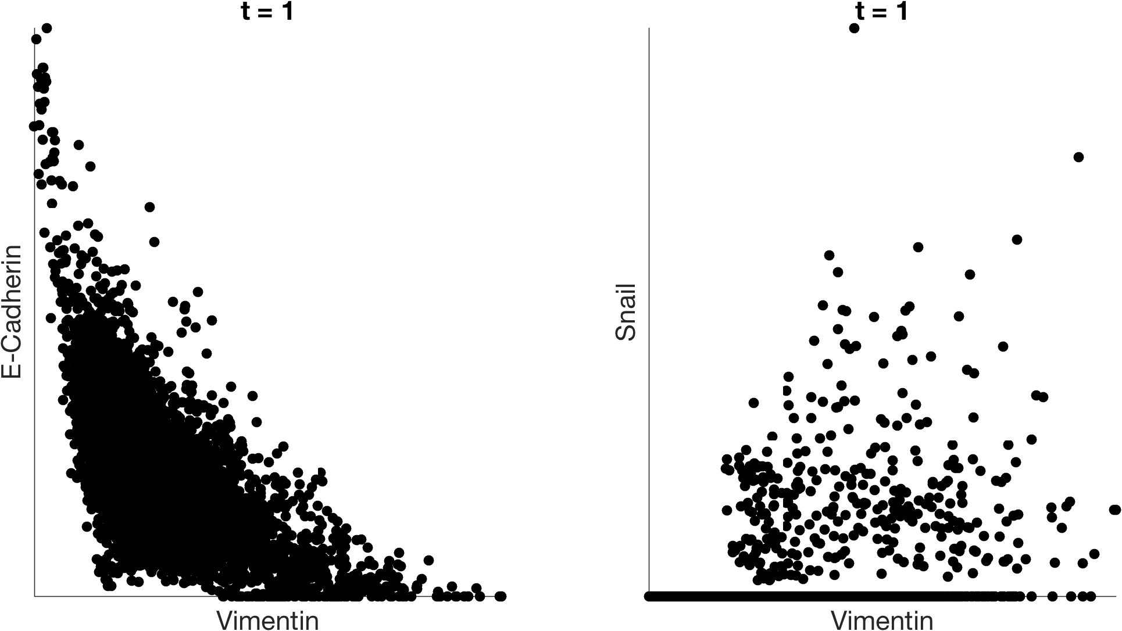
imputation with MAGIC

Slide 34
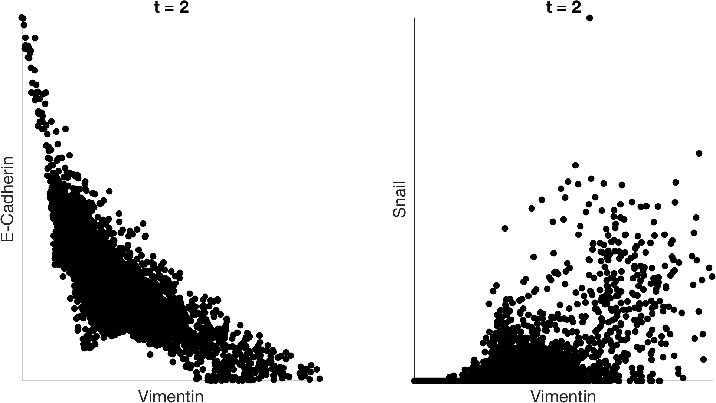
imputation with MAGIC

Slide 35
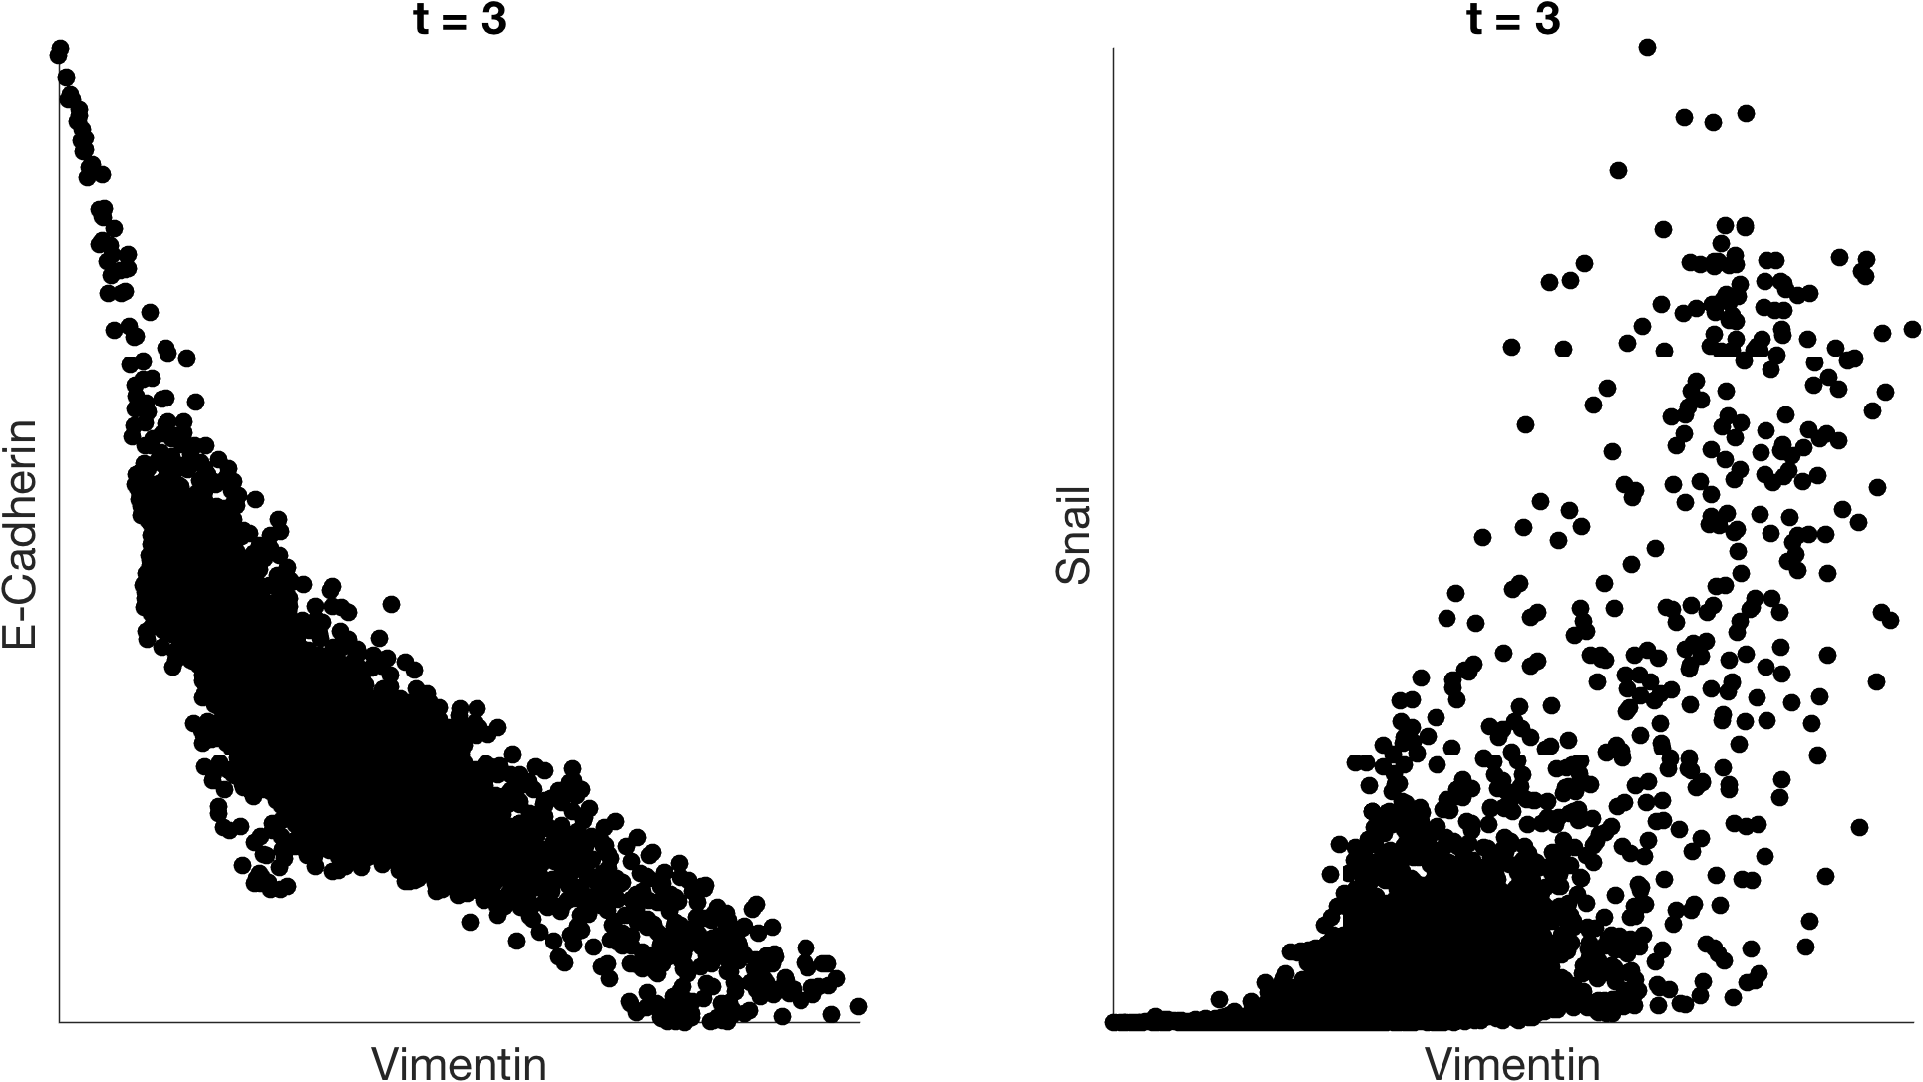
imputation with MAGIC

Slide 36
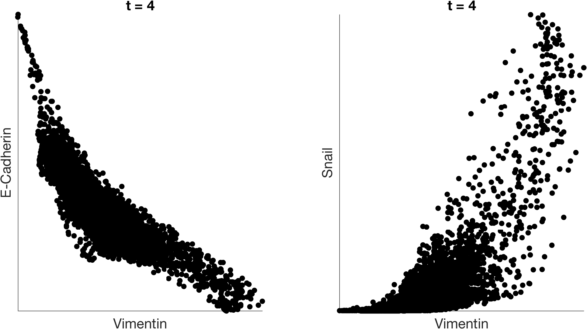
imputation with MAGIC

Slide 37
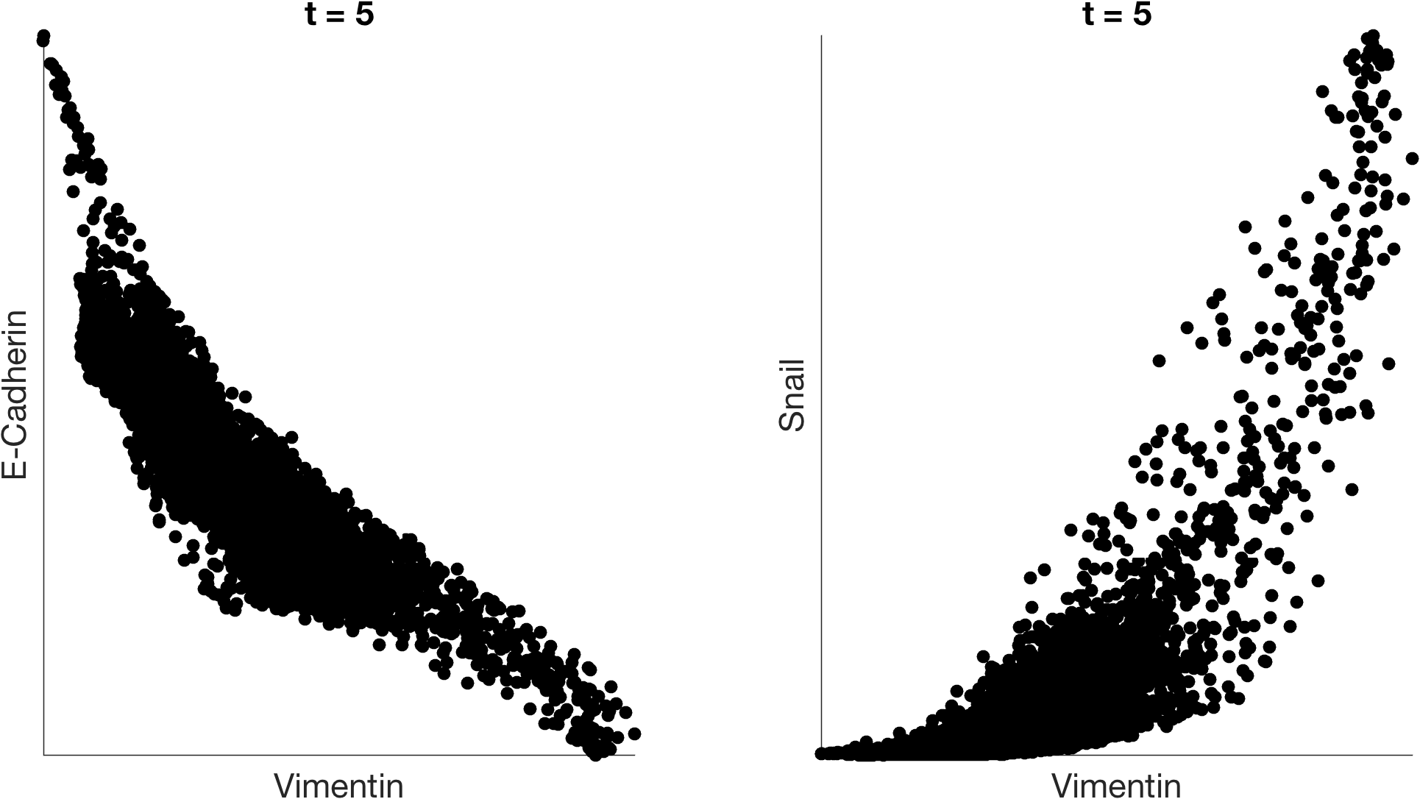
imputation with MAGIC

Slide 38
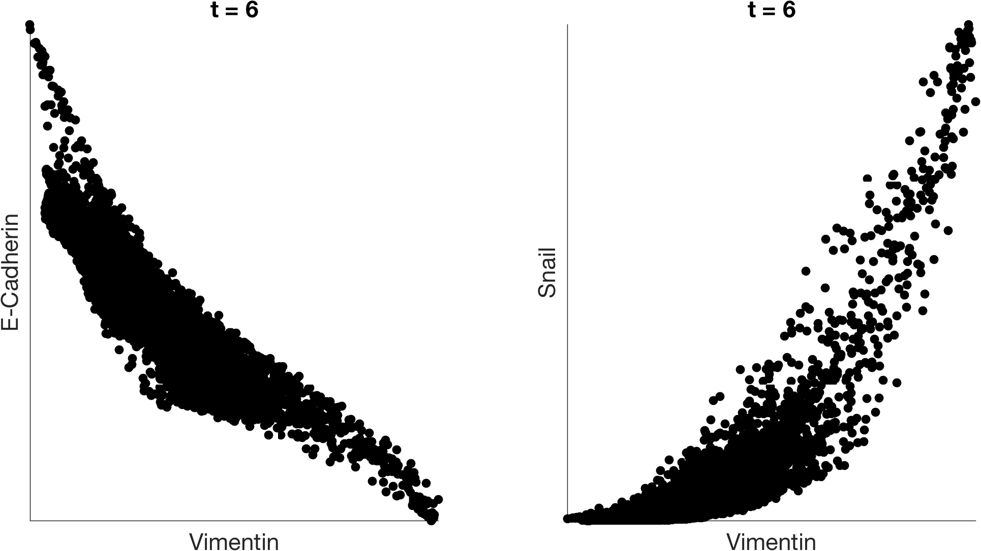
imputation with MAGIC

Slide 39
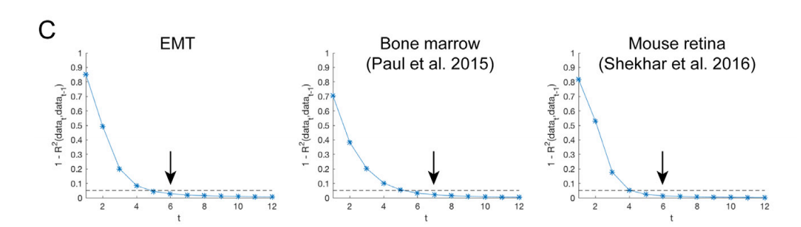
What t should we choose?
Separate “learning phase” from “stable phase”, quit when data stabilizes

Slide 40

Molecular Validation
https://www.biorxiv.org/content/10.1101/786269v1.abstract

Slide 41

MAGIC recovers gene-gene relationships in an artificially dropped-out dataset

Slide 42
Denoising vs Missing value Imputation
Denoising assumes that data has some noise, all entries have noise added to them
Missing value completion methods assume that the existing values are correct and that some values are missing (not measured)
Matrix completion is a way of filling in missing values
There is some literature in the single cell world trying to differentiate between true zeros and false zeros
People disagree on how this should be done
With a denoising viewpoint it is not necessary to distingsuish

Slide 43

Comparing MAGIC to LRA and matrix completion

Slide 44

Notes:
For what tasks is denoising necessary?
https://www.polleverywhere.com/free_text_polls/FdXlmGtYUXmUKXSuYUtCb

Slide 45

Restoring expressions of characteristic markers

Slide 46

GFAP - marker for astrocytes
With MAGIC
Without MAGIC

Slide 47

Understanding Gene Gene Relationships

Slide 48
Summary of data denoising
Diffusing or smoothing values over a graph can denoise data
This kind of denoising is similar to averaging expression values across neighbors
More diffusion = more denoising
What questions do you have?
Please submit on Slack

Slide 49
Batch correction
Notes:
TA introduction
Talk about not teaching code (not a programming workshop)

Slide 50
Batch Effects in Single Cell
Systematic, non-biological differences between samples due to measurement conditions
Differences could be due to ambient conditions (temperature, humidity), machine calibration, differences in titration, bead/antibody batch, etc
Sometimes refers to actually actual biological differences but those that are “uninteresting” (background demographics rather than immediate drug effect).

Slide 51

Problem with Batch Effect
Samples become hard to compare
All genes, cell types seem different!

Slide 52
How do we detect batch effect?
Visualization!

Slide 53


Diversity Measures
Diversity measures including Shannon entropy have been used to quantify the degree of “mixture” between samples
kBet [Buttner et al] compare global population proportions to local
A priori, we don’t know what the degree of mixture should be, but if batch correction works, it should increase

Slide 54

Batch Correction
Take off artifactual variation and keep biological variation!

Slide 55

Can we use PCA to correct batch effect?

Slide 56

Notes:
How could we use PCA or SVD to remove batch effect?
https://www.polleverywhere.com/free_text_polls/A8BHLXdXtwjBoRMpT3G0E

Slide 57

This noise is large scale
Could be potentially addressed by removing first PC

Slide 58
Problem with PCA
It can address a linear shift in the data
But cannot handle more complex non-linear effects

Slide 59

Cannonical Correlation Analysis
CCA : uses a variant of PCA that brings two sets of samples to a common space
Can cluster or perform other analysis in common space but cannot go back to original space
Finds linear axes of common variation
Thrown off by non-matching populations

Slide 60

Harmonic Alignment
Aligns the diffusion components of two datasets using a rigid rotation that maximizes
correlation of gene loadings onto eigenvectors
Simple rotation does not seem to handle all cases

Slide 61
Mutual Nearest Neighbors
Creates a graph between two datasets
Nearest neighbors in the other dataset could be “matching cells”
But they have to be mutual!
Mutual neighbors
Non-mutual neighbors

Slide 62

Mutual Nearest Neighbors
Use MNNs to find out the direction of the batch effect and correct it.

Slide 63
MNN with MAGIC
B1
B2
Within 1
From 1->2
From 2->1
Within 2
Uses softer affinity matrix and pulls the data in to correct the result

Slide 64


Slide 65
MNN with MAGIC Correction

Slide 66

Notes:
Is mutual nearest neighbor (MNN) normalization linear or non-linear?
https://www.polleverywhere.com/multiple_choice_polls/mnsSK1uYGDPag7UUXFzhc

Slide 67
Summary of data denoising
Batch effects are sample-specific changes in measurements
The goal of batch-normalization is to align cells of the same “type” across samples
Mutual nearest neighbors (MNN) normalized batches by matching cells that are both close to each other
What questions do you have?
Please submit on Slack

Slide 68
Ronald Fisher’s Principles of Experimental Design (1935)
Randomization
Avoid systematic biases in sample preparation and processing to create homogenous groups
Replication
Do the experiment multiple times
Controls
Make sure you have proper negative controls that isolate your experimental variable

Slide 69
Compositional Analysis
http://bit.ly/MELD_lecture
Notes:
TA introduction
Talk about not teaching code (not a programming workshop)

Slide 70
Single Cell Data
Samples
(1-10)
Cells
(1K – 10M)
Genes / Proteins
(10-10K)
http://bit.ly/MELD_lecture

Slide 71


Common experimental setup
Treat
Kernel used to build the graph
$$K\left(x_{i},x_{j}\right)=\exp\left(\frac{{\left\|x_{i}−x_{j}\right\|}^{2}}{2σ^{2} }\right)$$

Slide 72

Goal: Quantify difference in data density
Control
Data Density
Cell state

Slide 73

Goal: Quantify difference in data density
Control
After perturbation
Data Density
Data Density
Cell state
Cell state

Slide 74

Goal: Quantify difference in data density
Control
After perturbation
Effect of experiment
Data Density
Data Density
Δ Density
Cell state
Cell state
Cell state

Slide 75
Estimating sample density over a graph
Treat
Kernel used to build the graph
$$K\left(x_{i},x_{j}\right)=\exp\left(\frac{{\left\|x_{i}−x_{j}\right\|}^{2}}{2σ^{2} }\right)$$

Slide 76
Estimating sample density over a graph
Treat
Kernel used to build the graph
$$K\left(x_{i},x_{j}\right)=\exp\left(\frac{{\left\|x_{i}−x_{j}\right\|}^{2}}{2σ^{2} }\right)$$

Slide 77

Estimating sample density over a graph
Treat
Kernel used to build the graph
$$K\left(x_{i},x_{j}\right)=\exp\left(\frac{{\left\|x_{i}−x_{j}\right\|}^{2}}{2σ^{2} }\right)$$

Slide 78

Estimating sample density over a graph
Treat
Kernel used to build the graph
$$K\left(x_{i},x_{j}\right)=\exp\left(\frac{{\left\|x_{i}−x_{j}\right\|}^{2}}{2σ^{2} }\right)$$

Slide 79

Estimating sample density over a graph
Treat
Kernel used to build the graph
$$K\left(x_{i},x_{j}\right)=\exp\left(\frac{{\left\|x_{i}−x_{j}\right\|}^{2}}{2σ^{2} }\right)$$

Slide 80

Wagner D. et al. Science. 2018.

Slide 81


Slide 82


Slide 83

Analysis of replicates reveals heterogenous response

Slide 84
Analysis of replicates reveals heterogenous response

Slide 85

Analysis of replicates reveals heterogenous response

Slide 86


Chd Relative Likelihood

Slide 87
Chd Relative Likelihood

Slide 88



RL
Chd Relative Likelihood

Slide 89




bit.ly/quantsinglecell
github.com/KrishnaswamyLab/MELD
Coming soon!

